Slide 1
The Second Horse of the Apocalypse - Inflation
Part V

Slide 2
Updates
The Four Horsemen of the Apocalypse

Slide 3
Interesting Report on Health Care
The Tennessee Liberty Network released a report titled Follow the Money: Blood Money in U.S. Healthcare Financial Incentives
The Report outlines how the U.S. Government encouraged Hospitals to create COVID-19 Diagnosis offering them incentive money.
It also talks about incentives used to get educational institutions to come on board with the COVID-19 Protocols.
The report has been republished on the Alive on the Edge website.

Slide 4
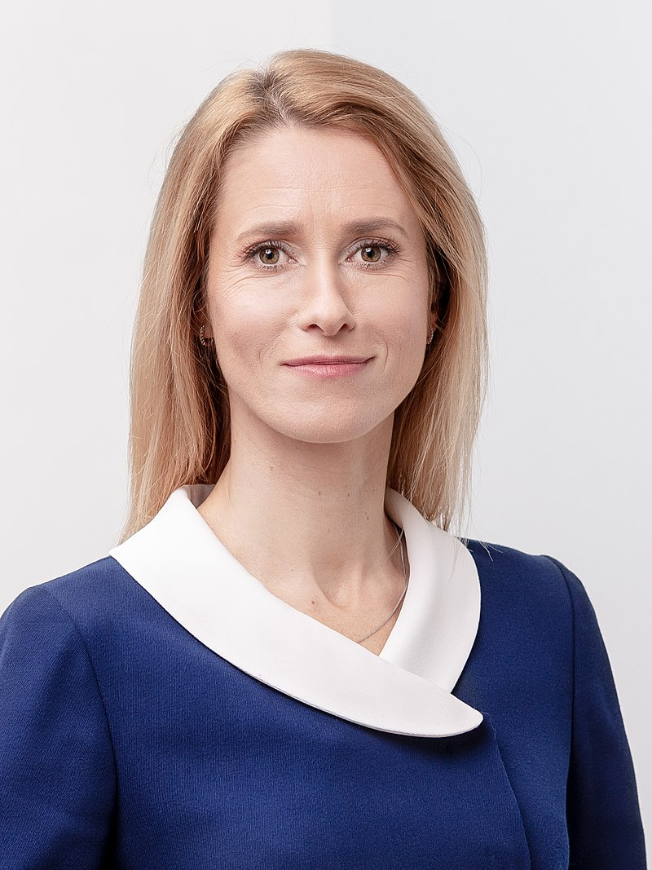
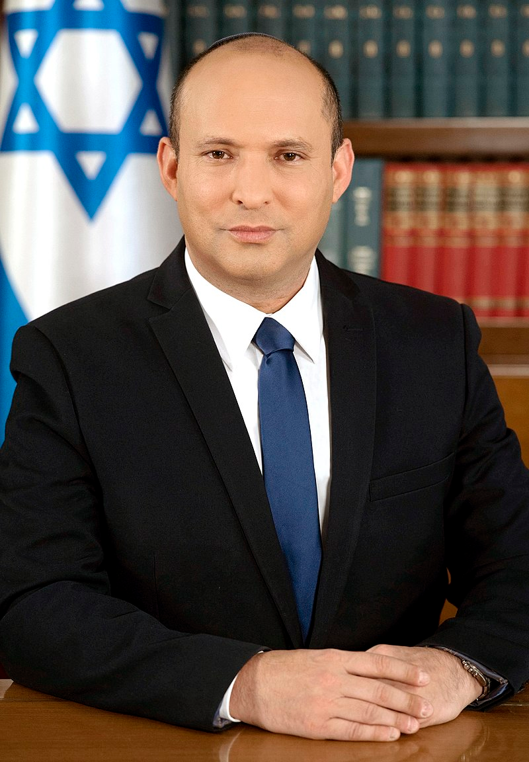
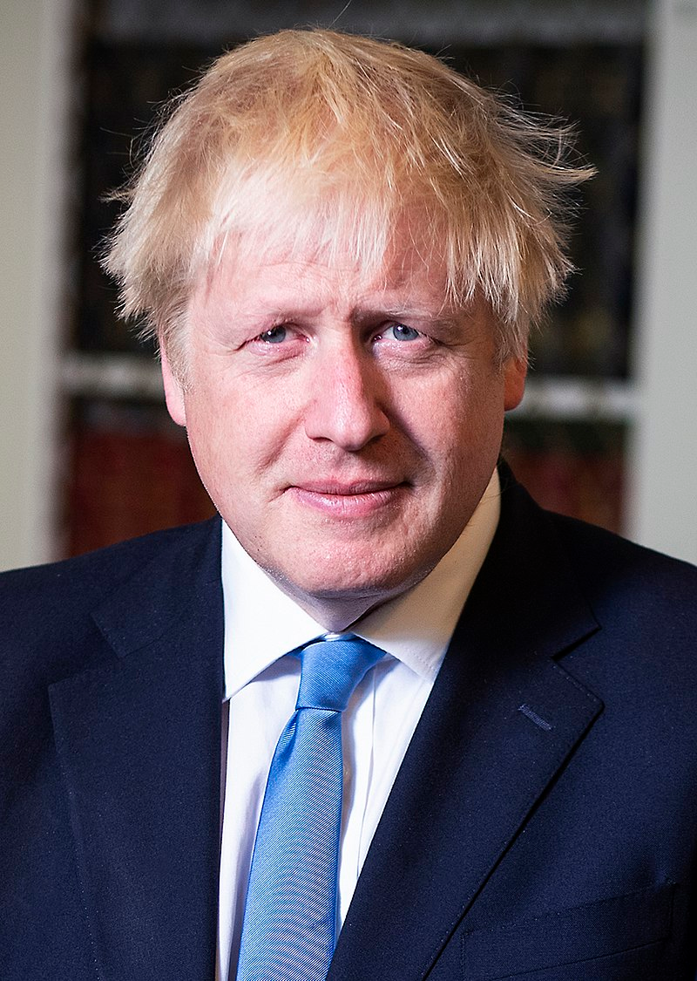
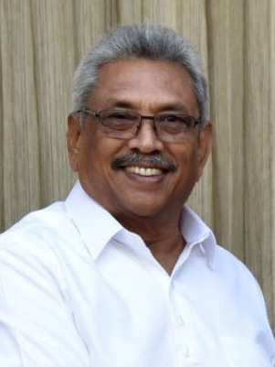
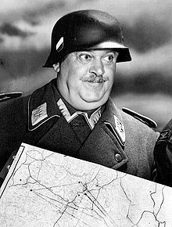
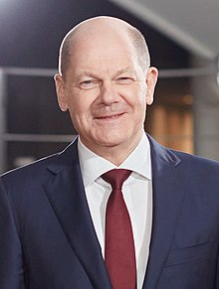
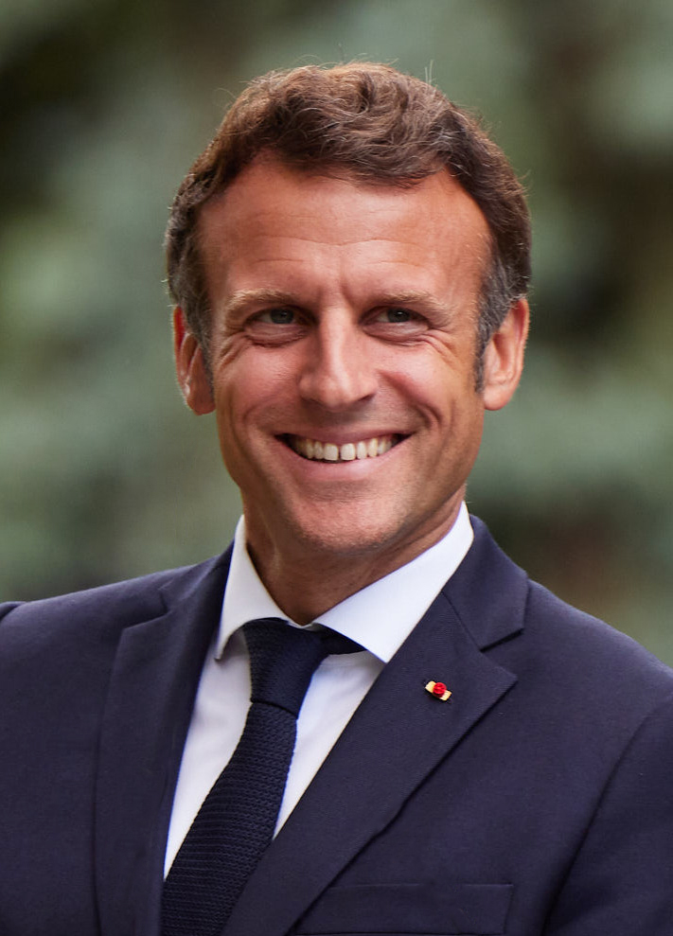
Resignations of World Leaders
Who has resigned their leadership role in the last few weeks?
Kaja Kallas - Estonia
Mario Draghi, Italy
Gotabaya Rajapaksa – Sri Lanka
Naftali Bennett, Israel
Boris Johnson, Great Britain
Who will be next?
Emmanuel Macron - France
Olaf Scholz - Germany

Slide 5
Bible Music Research
In anticipation of a trip to Heavener, Oklahoma later this summer, we did some more experimentation with our Bible Music Project.
Much of the research we previously did is on our website: http://biblemusic.live.
Much of that work from 2006-2012 centered around weather research and culminated with making it rain every day in June in 2012. Professor Mack was assisted by the late scientist: Olaf H. Hage III and Sound Engineer Chris Blodgett, both in the construction of the music and in the scientific elements.
On July 4, 2022, we embarked on a new project. In our first phase, we made music from Isaiah 9:8 to 13:33 in all 12 key signatures. We played the music out into the atmosphere for the first time that evening. Areas of drought suddenly got rain, but CERN did not operate as planned and there was a problem with the Georgia Guidestones.

Slide 6
Bible Music Research
In anticipation of a trip to Heavener, Oklahoma later this summer, we did some more experimentation with our Bible Music Project.
On July 22, 2022, I went to Colorado Springs, Colorado on personal business. While waiting in a waiting room at Memorial Hospital, I learned on local television that the city had experienced greater than average temperatures on 18 of 21 days on the month. They only had rain on three of those days.
Since I had “Rain Machine” on my phone, I started playing it in the waiting room of the Hospital. Within two hours of playing it, the clouds came off the mountain and it started raining heavily.

Slide 7
Bible Music Research
In anticipation of a trip to Heavener, Oklahoma later this summer, we did some more experimentation with our Bible Music Project.
In a follow-up to the Colorado Springs events, we noticed that the rain system missed Trinidad, Colorado. It is something that we have seen before. Even the late Stephen Hamer, M.S. (Meteorology) could account for the number of times that storm systems bypassed Trinidad, Colorado.
This time, we played Zechariah, chapters 13-14 into the air. Within two hours, thunderstorms came over the mountains and continued for much of the night.
Continuous thunderstorms are rare in Trinidad, Colorado, as the city is on the Northeast corner of the Great Southwestern Desert of the United States.

Slide 8
WhiteStone Foundation Music Research
In anticipation of a trip to Heavener, Oklahoma later this summer, we did some more experimentation with our Bible Music Project.
Bible Music for Isaiah 9:8 – 13:22. MP3 File.
Bible Music for Zechariah 13-14. MP3 File.
Bible Music for Zechariah 13-14. FLAC File.
Here is the key verse:
In that day there shall be a fountain opened to the house of David and to the inhabitants of Jerusalem for sin and for uncleanness. (Zechariah 13:1)
We are getting ready to post additional scriptures. If some of you have suggestions for scriptures to render into music, let us know. tom.mack@whitestonsfoundation.org.

