Slide 1
The Second Horse of the Apocalypse - Inflation
Part VII

Slide 2
Updates
The Four Horsemen of the Apocalypse

Slide 3
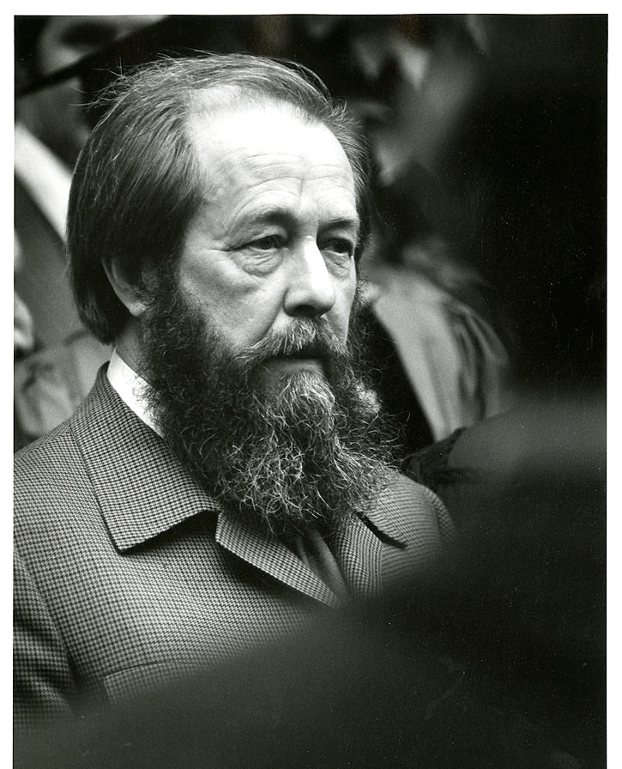
"The simple step of a courageous individual is not to take part in the lie. One word of truth outweighs the world."
Aleksandr Solzhenitsyn

Slide 4
"You can resolve to live your life with integrity. Let your credo be this: Let the lie come into the world, let it even triumph. But not through me."
Aleksandr Solzhenitsyn

Slide 5
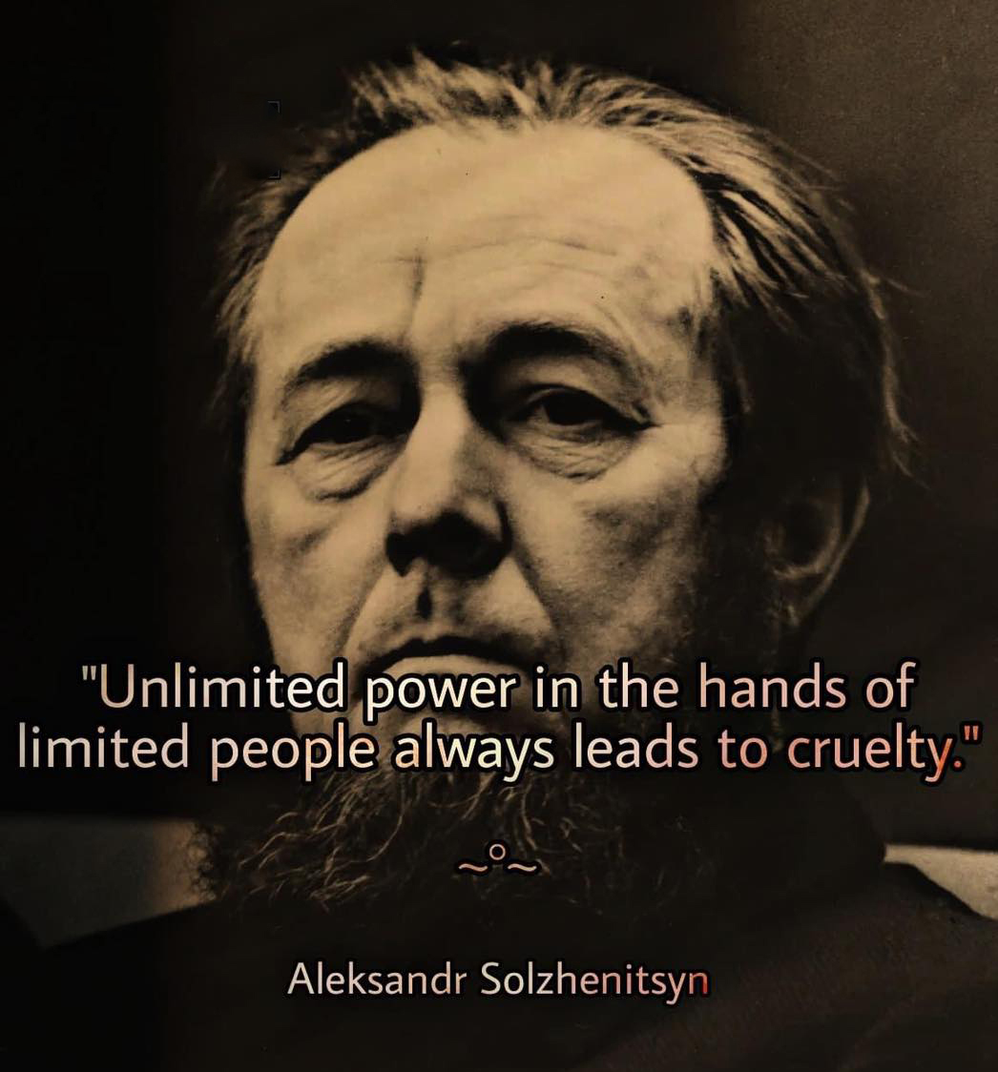

Slide 6
"Modern society is hypnotized by socialism. It is prevented by socialism from seeing the mortal danger it is in. And one of the greatest dangers of all is that you have lost all sense of danger, you cannot even see where it's coming from as it moves swiftly towards you." Aleksandr Solzhenitsyn

Slide 7
“We are at the edge of war with Russia and China on issues which we partly created,
without any concept of how this is going to end or what it’s supposed to lead to.”

Slide 8
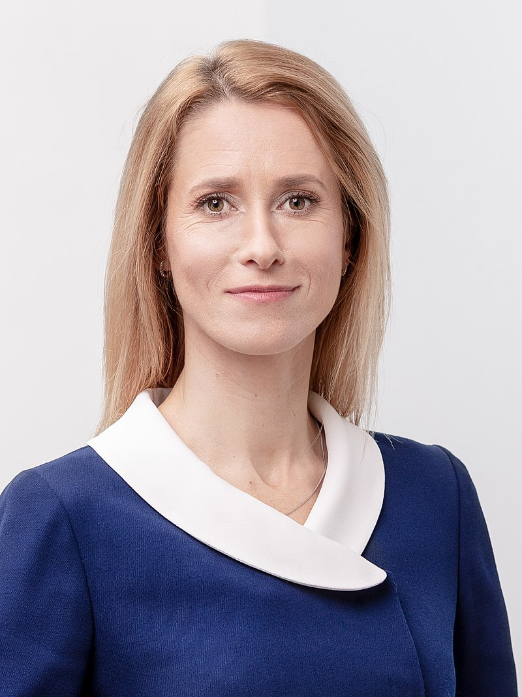
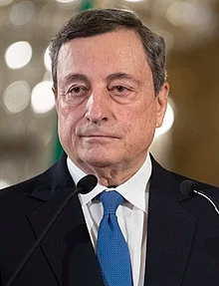
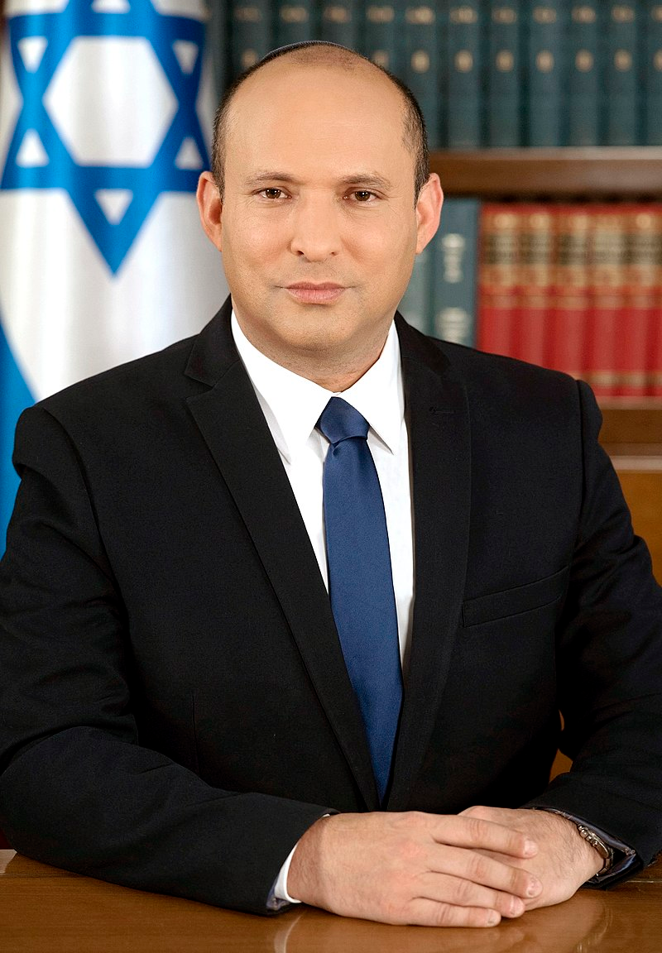
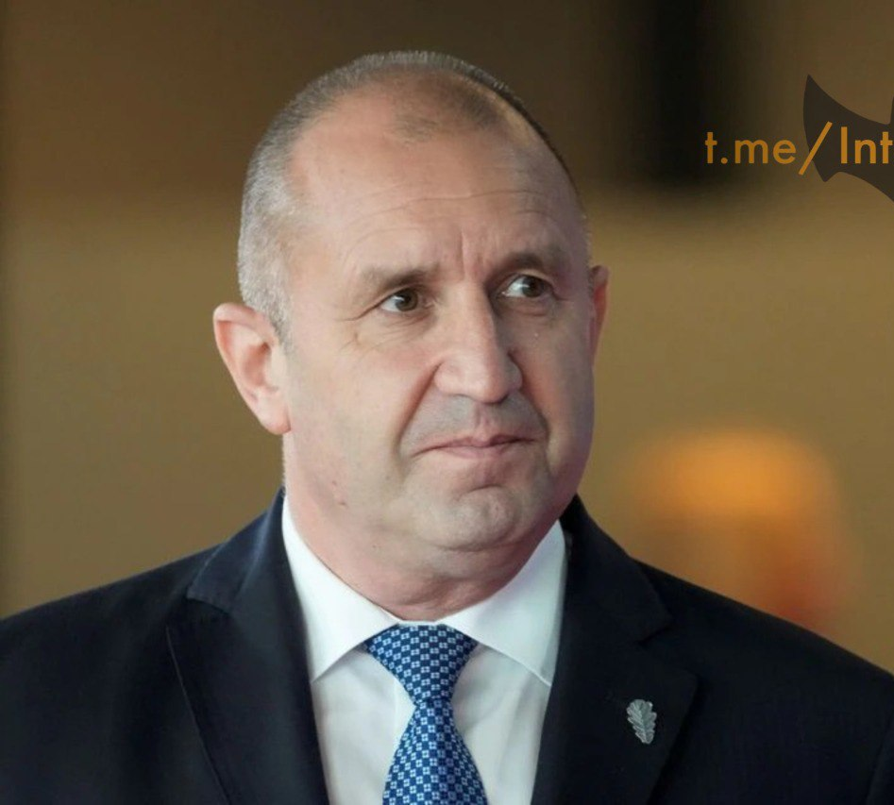
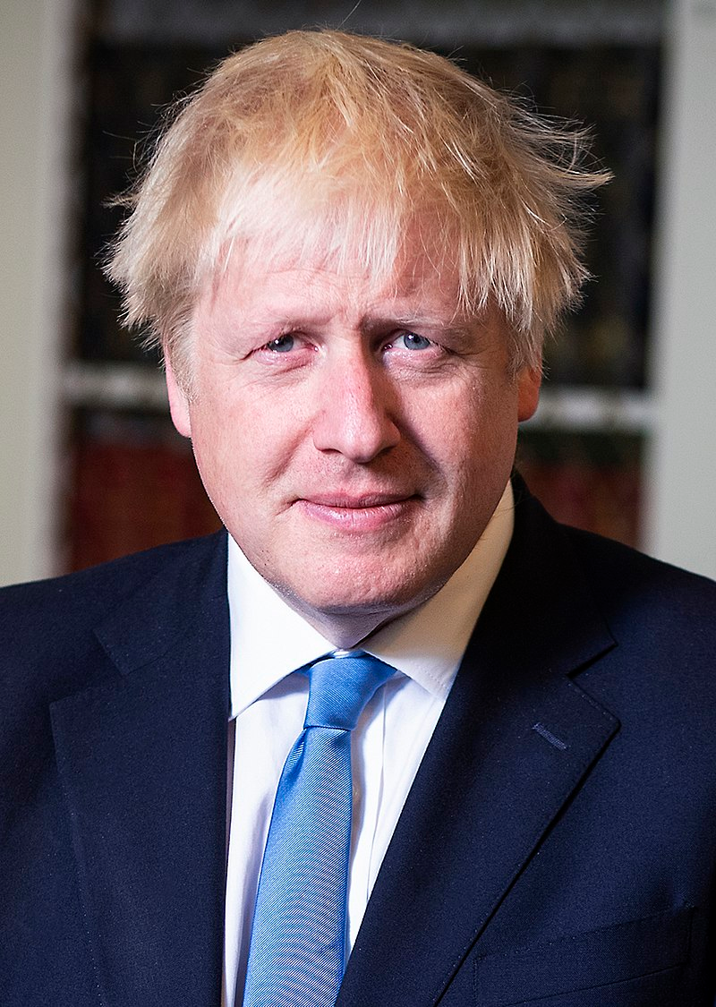
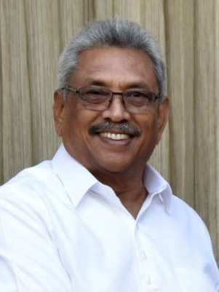
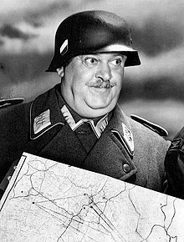
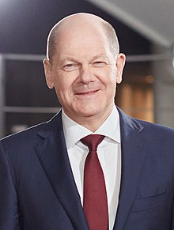
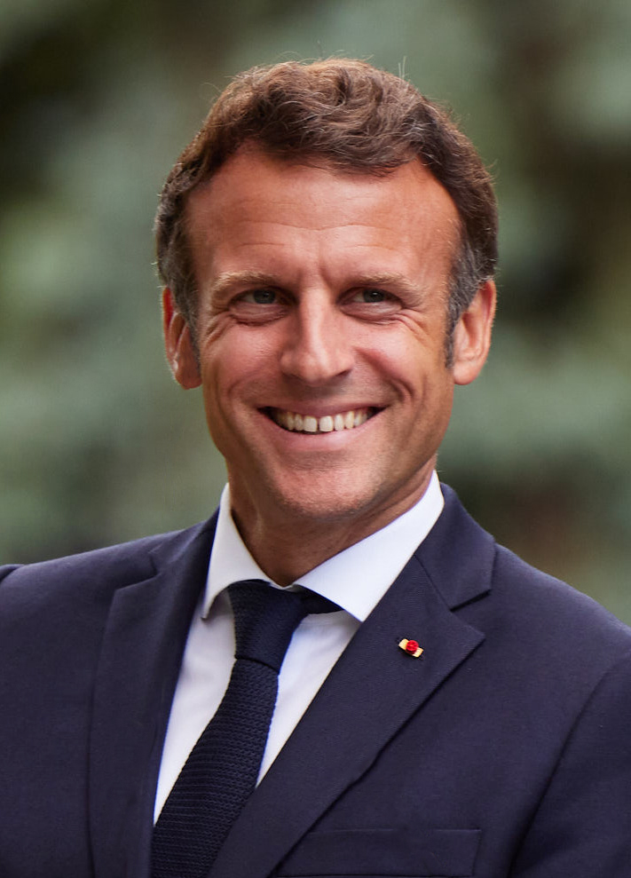
Resignations of World Leaders
Who has resigned their leadership role in the last few weeks?
Kaja Kallas - Estonia
Mario Draghi, Italy
Gotabaya Rajapaksa – Sri Lanka
Naftali Bennett, Israel
Boris Johnson, Great Britain
Rumen Radev, Bulgaria
Who will be next?
Emmanuel Macron - France
Olaf Scholz - Germany

Slide 9
Drought
The Battle to Starve America

Slide 10
The Summer of Drought
The World Economic Forum’s Directive for Centuries has been to Reduce the World’s Population to “Sustainable Levels.”
They have accomplished this by Creating a War between Russia and Ukraine.
They did this by weaponizing Ukraine with Western Military Goods and Placing Bio-Labs in the Country.
When Russia moved to protect their interests, the EU “sanctioned” Russia. Now, the world lacks the fertilizer needed to grow their crops. Couple this with droughts caused by HAARP and other technologies and we are headed for trouble. Look at the first Map from July 2022.

Slide 11
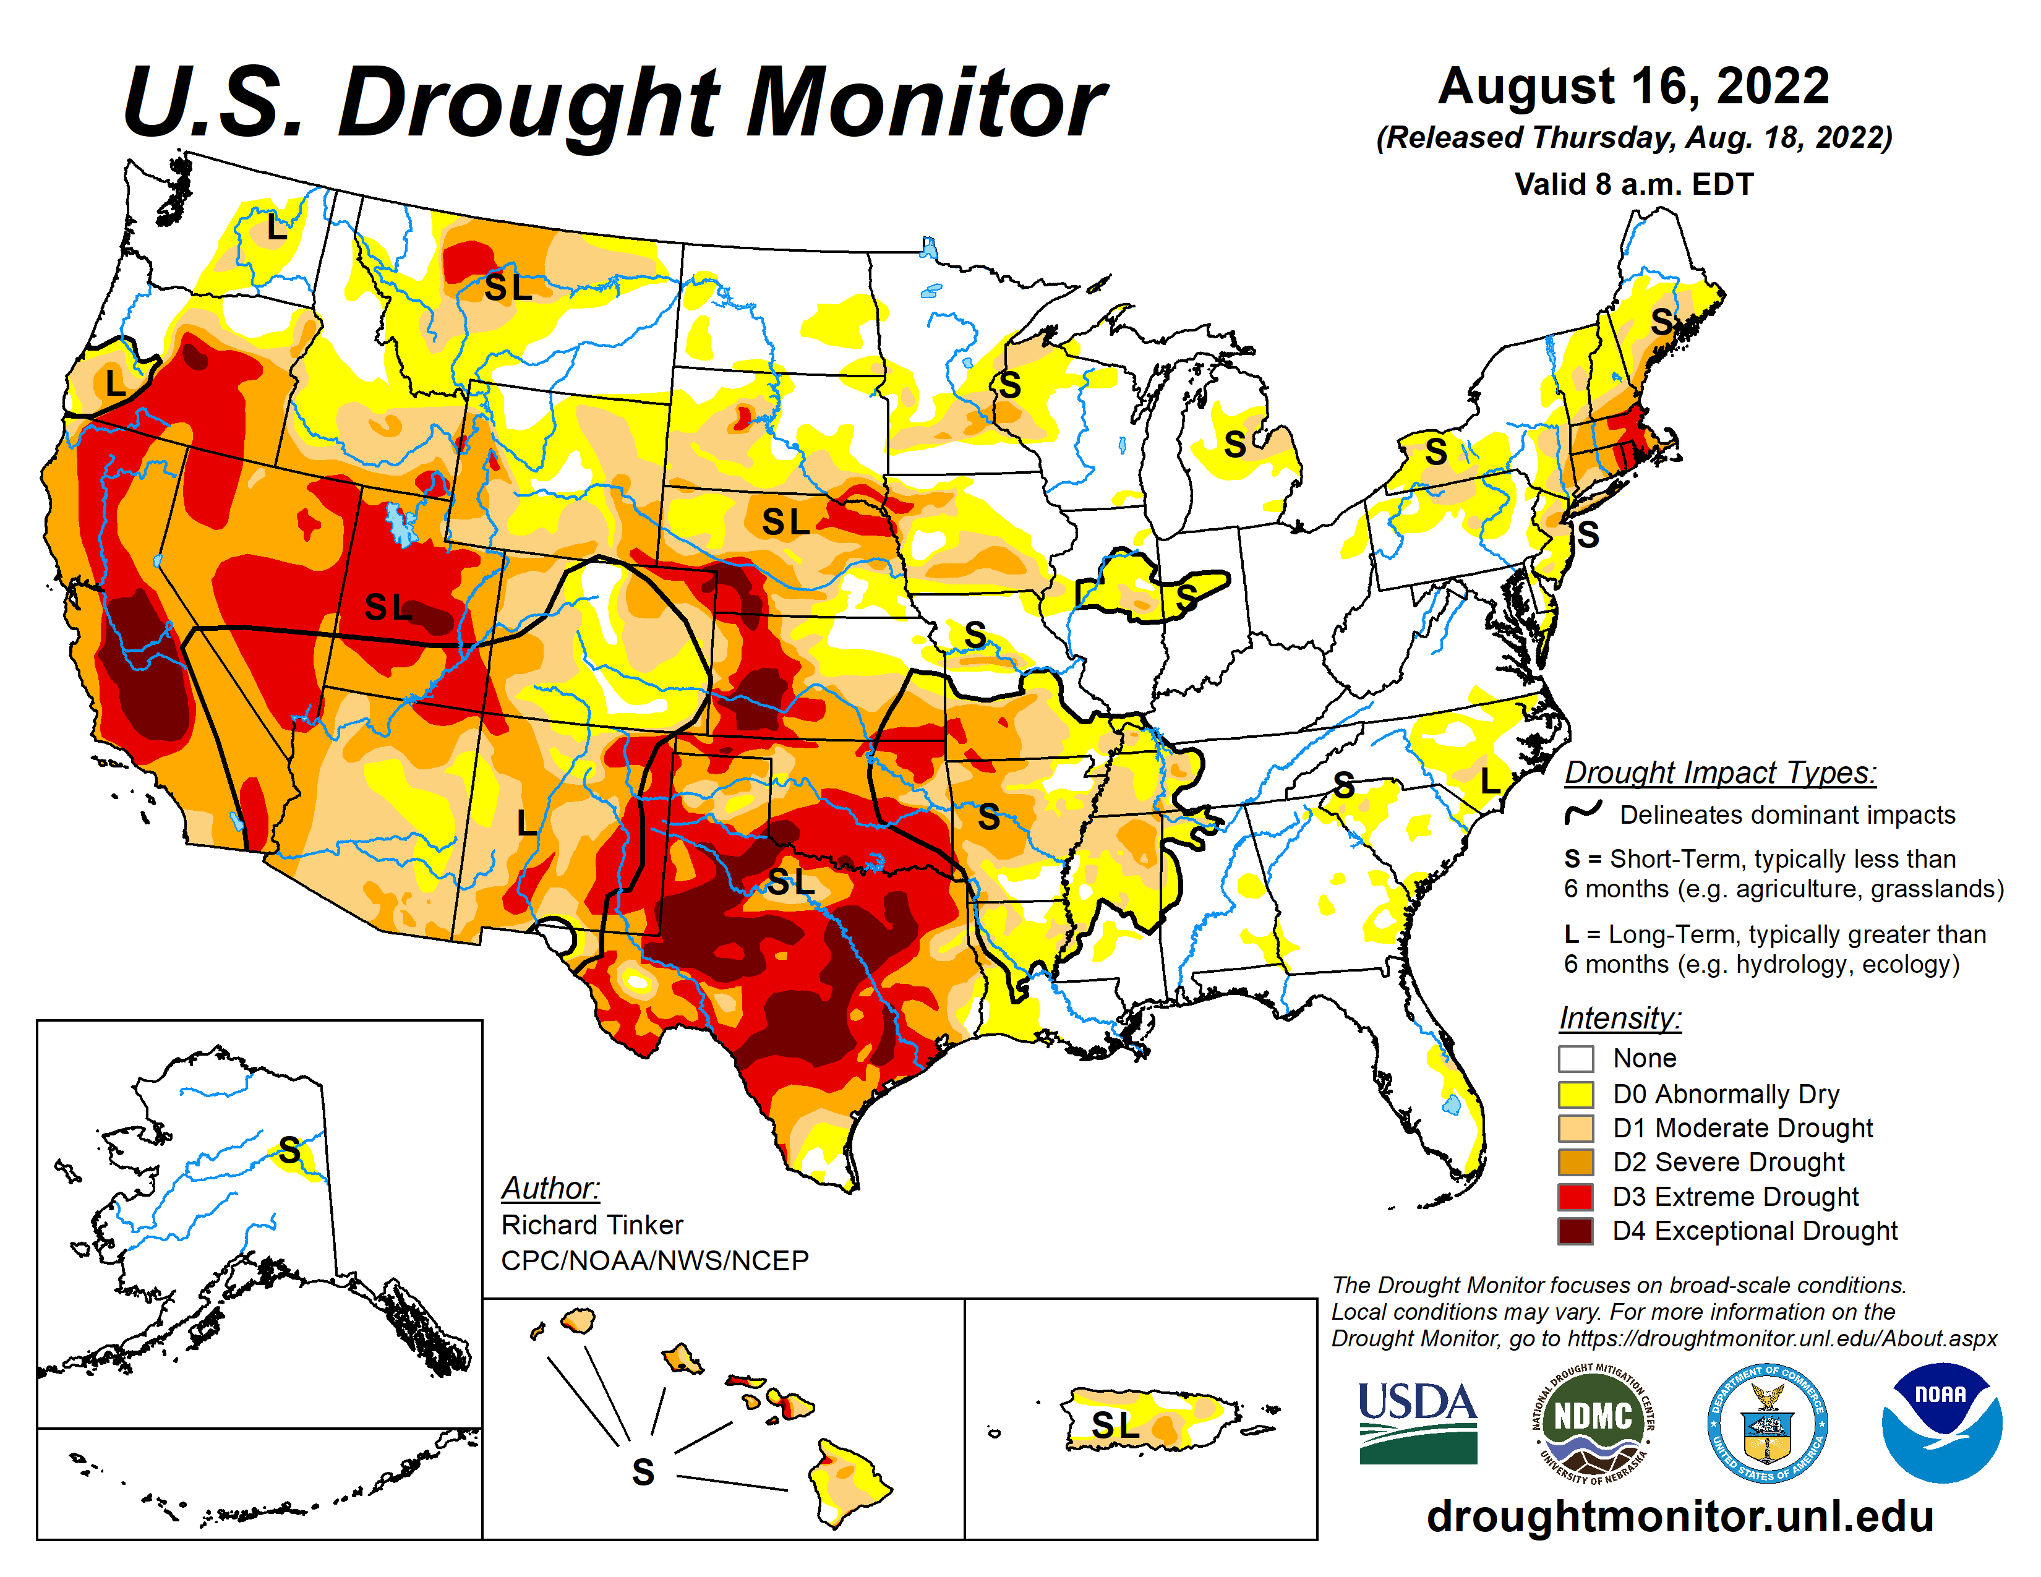

Slide 12
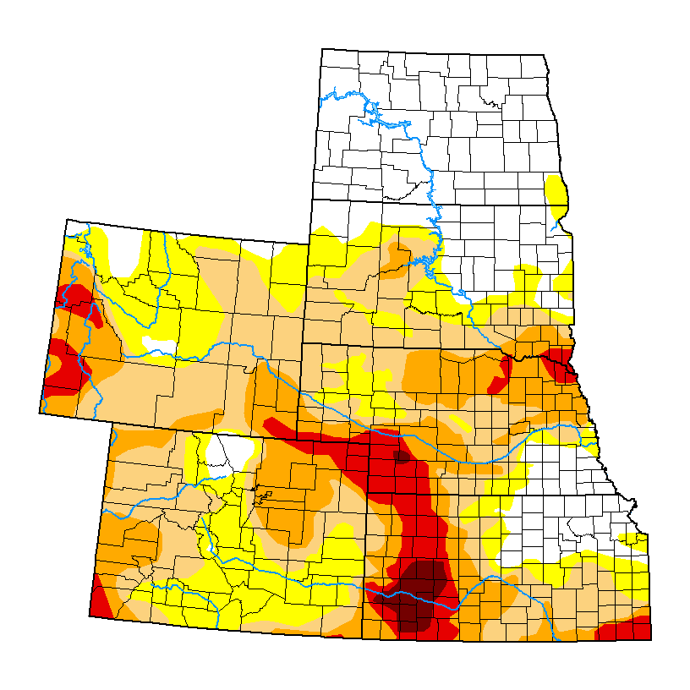

Slide 13
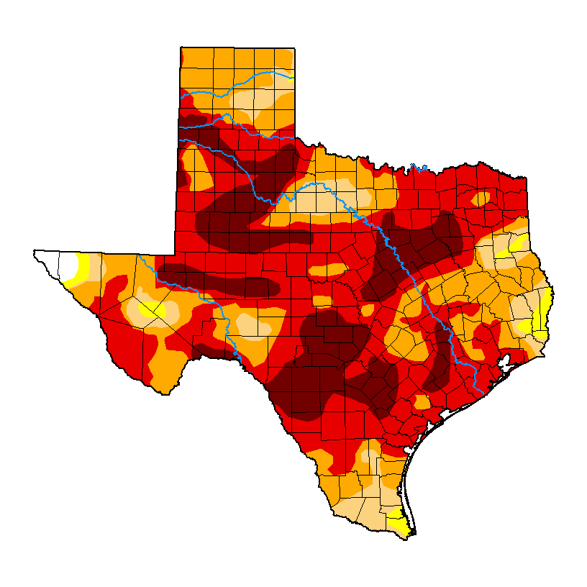

Slide 14
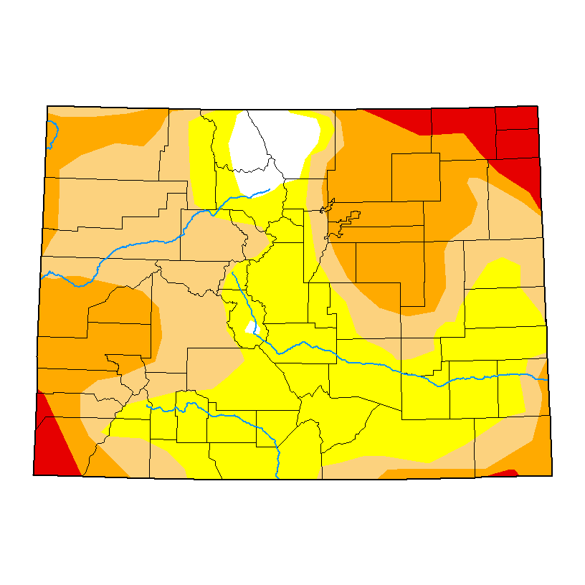

Slide 15
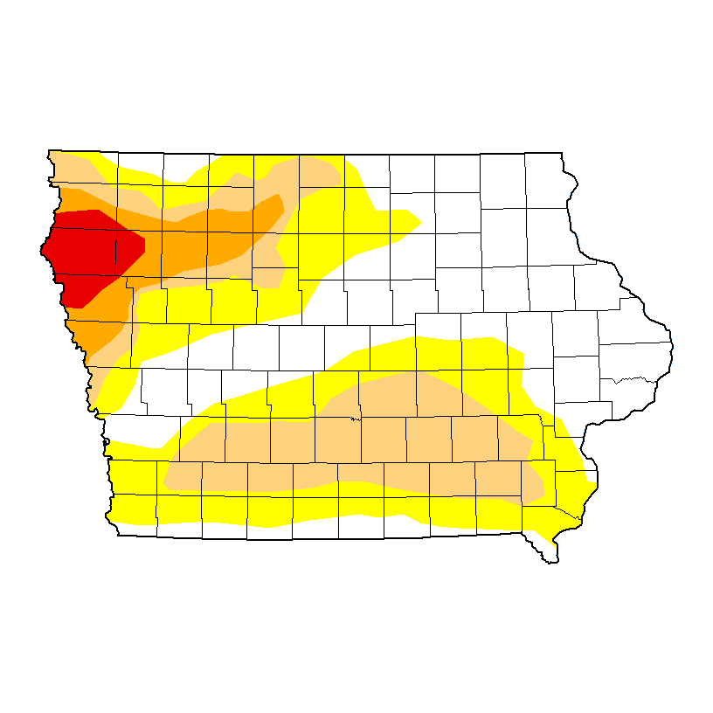

Slide 16
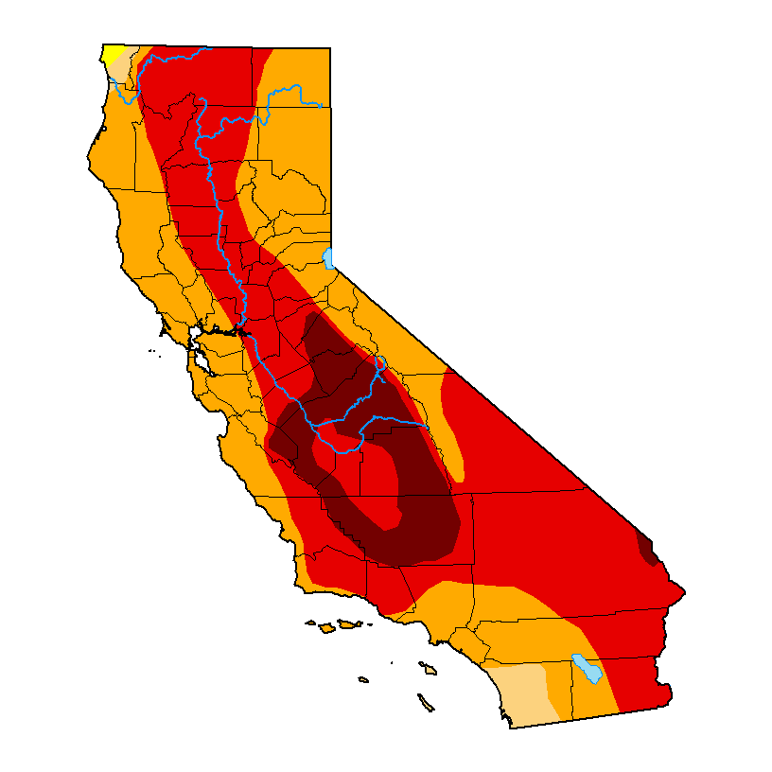

Slide 18
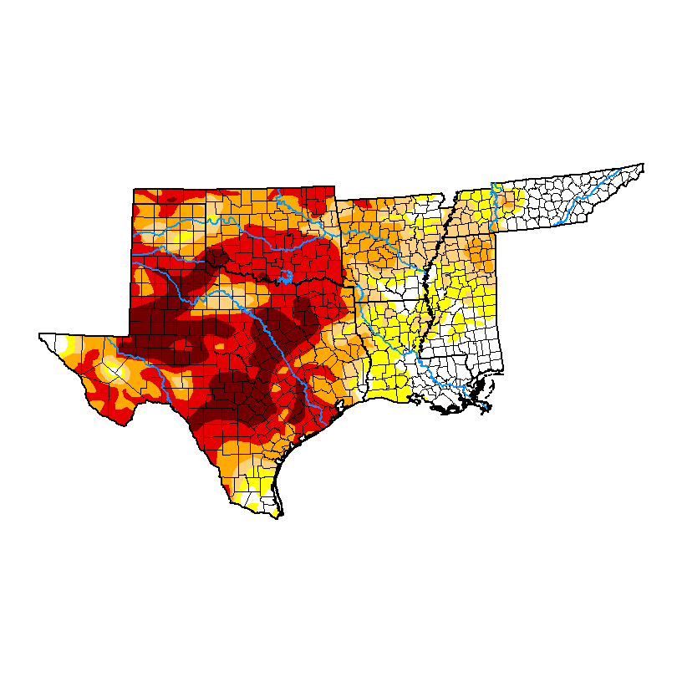

Slide 19
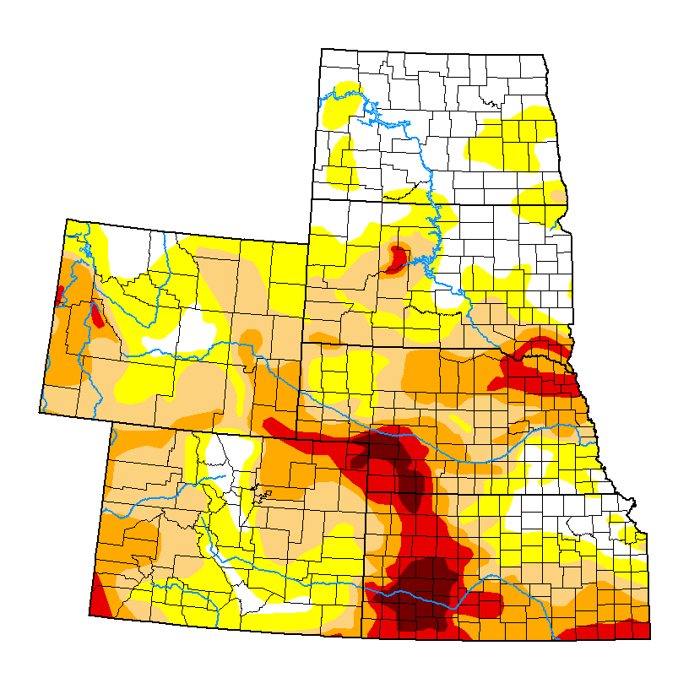

Slide 20
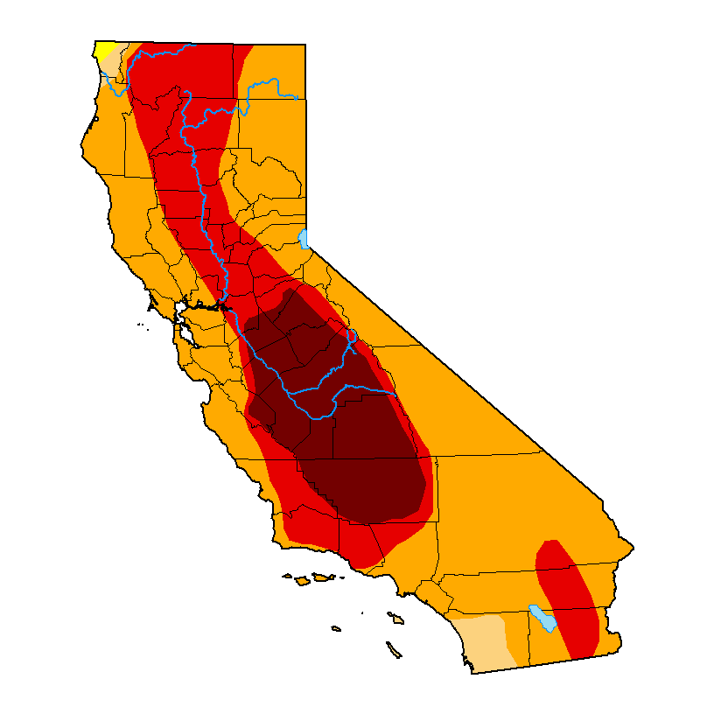

Slide 21
Bible Music Research
In anticipation of a trip to Heavener, Oklahoma later this summer, we did some more experimentation with our Bible Music Project.
Much of the research we previously did is on our website: http://biblemusic.live.
Much of that work from 2006-2012 centered around weather research and culminated with making it rain every day in June in 2012. Professor Mack was assisted by the late scientist: Olaf H. Hage III and Sound Engineer Chris Blodgett, both in the construction of the music and in the scientific elements.
On July 4, 2022, we embarked on a new project. In our first phase, we made music from Isaiah 9:8 to 13:33 in all 12 key signatures. We played the music out into the atmosphere for the first time that evening. Areas of drought suddenly got rain, but CERN did not operate as planned and there was a problem with the Georgia Guidestones.

Slide 22
Bible Music Research
In anticipation of a trip to Heavener, Oklahoma later this summer, we did some more experimentation with our Bible Music Project.
On July 22, 2022, I went to Colorado Springs, Colorado on personal business. While waiting in a waiting room at Memorial Hospital, I learned on local television that the city had experienced greater than average temperatures on 18 of 21 days on the month. They only had rain on three of those days.
Since I had “Rain Machine” on my phone, I started playing it in the waiting room of the Hospital. Within two hours of playing it, the clouds came off the mountain and it started raining heavily.

Slide 23
Bible Music Research
In anticipation of a trip to Heavener, Oklahoma later this summer, we did some more experimentation with our Bible Music Project.
In a follow-up to the Colorado Springs events, we noticed that the rain system missed Trinidad, Colorado. It is something that we have seen before. Even the late Stephen Hamer, M.S. (Meteorology) could account for the number of times that storm systems bypassed Trinidad, Colorado.
This time, we played Zechariah, chapters 13-14 into the air. Within two hours, thunderstorms came over the mountains and continued for much of the night.
Continuous thunderstorms are rare in Trinidad, Colorado, as the city is on the Northeast corner of the Great Southwestern Desert of the United States.

Slide 24
WhiteStone Foundation Music Research
In anticipation of a trip to Heavener, Oklahoma later this summer, we did some more experimentation with our Bible Music Project.
Bible Music for Isaiah 9:8 – 13:22. MP3 File.
Bible Music for Zechariah 13-14. MP3 File.
Bible Music for Zechariah 13-14. FLAC File.
Here is the key verse:
In that day there shall be a fountain opened to the house of David and to the inhabitants of Jerusalem for sin and for uncleanness. (Zechariah 13:1)
We are getting ready to post additional scriptures. If some of you have suggestions for scriptures to render into music, let us know. tom.mack@whitestonefoundation.org.

Slide 25
WhiteStone Foundation Music Research
You can follow our most recent research on our Telegram Channel:
https://t.me/Bible_Music1
Our Website for this music is:
http://biblemusic.live

Slide 26
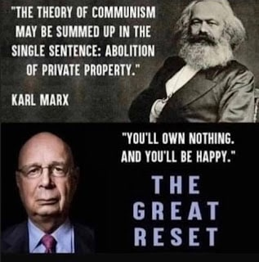
Creeping Socialism

