Slide 1
The Mark of the Beast
The time of the end is fast approaching – Prof. Tom Mack – Maj. Tom Baird (ret.)

Slide 2
The Sealed 144,000
And I saw another angel ascending from the east, having the seal of the living Elohiym: and he cried with a loud voice to the four angels, to whom it was given to hurt the earth and the sea,
Saying, Hurt not the earth, neither the sea, nor the trees, till we have sealed the servants of our Elohiym in their foreheads. (Revelation 7:2-3)

Slide 3
Interesting Book
Here is a recently published book that outlines new ideas about what the Mark of the Beast could be. We will be using some of this author’s ideas.
We also borrowed some ideas from a presentation by attorney Dr. Stephen Pidgeon. Here is a link to his presentation.

Slide 4
The Sealed 144,000
Seal (σφραγίς) Sphragis a signet, an impressed stamp certifying genuineness of an item.
We find these seals on Microsoft software, in their efforts to fight software piracy.
We find similar seals on food products and liquors to certify their genuineness.

Slide 5
The Sealed 144,000
And I heard a voice from heaven, as the voice of many waters, and as the voice of a great thunder: and I heard the voice of kitharists playing with their kithara:
And they sung as it were a new song before the throne, and before the four living creatures, and the elders: and no man could learn that song but the hundred and forty and four thousand, which were redeemed from the earth.
These are they which were not defiled with women; for they are virgins. These are they which follow the Lamb whithersoever he goes. These were redeemed from among men, being the firstfruits unto Elohiym and to the Lamb. (Revelation 14:2-4)

Slide 6
The Sealed 144,000
Meta (μετά) around or among, the translation “with” in the 17th century had NO sexual connotations! That was added by preachers in the 20th century.
After – 88/120 = 73.3%
Only once is it translated “with.” Less than 1% of the time.

Slide 7
The Sealed 144,000
The Main Question: What is so important about the number 144,000?
Mathematical Breakdown:
144,000 = 2⁷ x 3² x 5³
144,000 = (2 x 2 x 2 x 2 x 2 x 2 x 2) x (3 x 3) x (5 x 5 x 5)
144,000 = 128 x 9 x 125
Two, Three, Five, and Seven are the first three Prime Numbers (numbers divisible by themselves and one only). Stronger substances are built on lower prime numbers.

Slide 8
Invading the Temple
One of Ancient Evil’s Goals since the days of Genesis 6 is to somehow invade the Temple… what temple? The Temple of the Holy Spirit.
What? know ye not that your body is the temple of the Holy Spirit which is in you, which ye have of YHWH, and ye are not your own? For ye are bought with a price: therefore glorify YHWH in your body, and in your spirit, which are His. (1 Corinthians 6:19-20)
Temple (Strong’s #G2385) Greek: ναός (naos) A dwelling of a deity, used figuratively of individuals.

Slide 9
Invading the Temple
One of Ancient Evil’s Goals since the days of Genesis 6 is to somehow invade the Temple… what temple? The Temple of the Holy Spirit.
Who opposeth and exalteth himself above all that is called elohim, or that is worshipped; so that he as elohim sitteth in the temple of elohim, shewing himself that he is elohim. (II Thessalonians 2:4)
Ancient Evil’s goal is to sit in the Temple of YHWH’s creation and make himself the elohim of it.
Is he accomplishing that task???

Slide 10
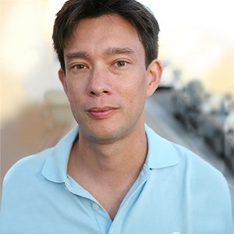
The New Helix
Dr. Jason Chin, in a 2010 paper, announced a “breakthrough” where he was able to create a “triple helix” as the new “molecule of life.” By combining Nucleic Acid as a synthetic hybrid of protein and DNA (source unspecified), artificial life could be “obtained.” The additional helix, in order to balance against the genetic code of the double helix, would contain 72,000 genes.
Dr. Jason W. Chin, Ph.D.
Scripps Research Institute
Cambridge, England, U.K.

Slide 11
Messenger RNA (mRNA)
Messenger RNA (abbreviated mRNA) is a type of single-stranded RNA involved in protein synthesis. mRNA is made from a DNA template during the process of transcription. The role of mRNA is to carry protein information from the DNA in a cell’s nucleus to the cell’s cytoplasm (watery interior), where the protein-making machinery reads the mRNA sequence and translates each three-base codon into its corresponding amino acid in a growing protein chain.
https://www.genome.gov/genetics-glossary/messenger-rna

Slide 12
Messenger RNA (mRNA)
Messenger RNA or mRNA. So, mRNA really is a form of nucleic acid, which helps the human genome which is coded in DNA to be read by the cellular machinery. So, we have DNA in our nuclei. And then we have ribosomes and other cellular organelles which translate DNA. But between the DNA code itself, and the machinery that uses DNA to make proteins, there has to be a translator. And mRNA is actually the translated form of DNA that the machinery can recognize and use to assemble amino acids into proteins. So, this is really a fundamental link between what we think of as being the code of life and the actual cell being able to construct a living organism. And in that sense, although DNA gets discussed a lot more than RNA, mRNA is a really crucial piece of the fundamental way in which the living organism is created.
https://www.genome.gov/genetics-glossary/messenger-rna

Slide 13
The Key Verses
And that no man might buy or sell, save he that had the mark, or the name of the beast, or the number of his name. Here is wisdom.
Let him that has understanding calculate the number of the beast: for it is the number of a man; and his number is χξς.(chi, tsi, stigma) (Hebrew Equivalents חצת Hebrew Numeric values: 8, 90, 400) (Greek numeric values: 600, 60, 6) (Revelation 13:17-18)

Slide 14
Definitions
Count (KJV) Calculate (Cepher) psephizo
To count with pebbles
To give one’s vote by casting a pebble into the urn
To compute or calculate

Slide 15
History of Calculation
Calculation – History
In the Middle East in the first century, modern mathematics did not exist. Even the number “0” did not exist.
Even multiplication as we know it did not exist until the middle ages. In ancient times, multiplication tables were developed and used.
China and India were the first to develop modern multiplication tables and methods to multiply numbers.

Slide 16
History of Calculation II
Calculation – History
Modern mathematics did not come to the West until the 14th century when Leonardo Fibonacci brought modern accounting and Indian numbers with him to Pisa in what is now Italy. With Indian numbers, calculation became much easier.
Mathematics in the West advanced considerably with the introduction of Indian Numbers… Arithmetic, Algebra, Geometry, Calculus, Probability Theory…

Slide 17
Calculating the Number of the Beast
Alternative One – Addition:
600 + 60 + 6 = 666
Alternative Two – Subtraction:
600 – 60 – 6 = 534
Alternative Three – Division:
600/60 = 10/6 = 1.666666666…

Slide 18
Calculating the Number of the Beast
Alternative Four – Multiplication:
600 x 60 x 6 = 216,000
This number matches the number of genes found in the Triple Helix DNA designed in Cambridge, England.
216,000 / 3 = 72,000 number of genes in one strand of DNA.
And if one prevail against him, two shall withstand him; and a threefold cord is not quickly broken. (Ecclesiastes 4:12)

Slide 19
Calculating the Number of the Beast
And he causes all, both small and great, rich and poor, free and bond, to receive a mark in their right hand, or in their foreheads: And that no man might buy or sell, save he that had the mark, or the name of the beast, or the number of his name. Here is wisdom. Let him that has understanding calculate the number of the beast: for it is the number of a man; and his number is χξς. (Revelation 13:16-18)
The mark of the beast then is the Triple Helix, which is introduced into human beings via the “jab.”
The jab contains the mRNA that starts the conversion of the human being into a modified form. But what is the modified form?

Slide 20
Calculating the Number of the Beast
144,000 genes breaks down to:
2⁷
3²
5³
216,000 genes breaks down to:
2⁶
3³
5³
Notice that the perfect number has been removed from the gene set and the number six has been added. It is NOT a Prime Number therefore it is NOT a stable system. It is no wonder so many people are dying.

Slide 21
Calculating the Number of the Beast
Many movies and television shows have proposed to modify the human genome for nefarious purposes, but the Quatermass series, first put out by British movie maker ITV and later by Hammer Films offered two ideas.
Quatermass II: Enemy from Space
Quatermass: Conclusion

Slide 22
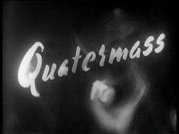
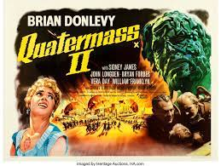
Interesting Movie Serial from 1955
Quatermass II
Quatermass II: Enemy from Space

Slide 23
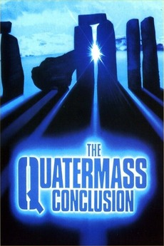
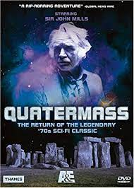
Interesting Movie Serial from 1979
Quatermass: Conclusion
Part I: Ringstone Round
Part II: Lovely Lightning
Part III: What Lies Beneath
Part IV: An Endangered Species

Slide 24
Redemption from the Mark?
So shall ye know that I am YHWH your Elohim dwelling in Zion, my holy mountain: then shall Jerusalem be holy, and there shall no strangers pass through her any more.
And it shall come to pass in that day, that the mountains shall drop down new wine, and the hills shall flow with milk, and all the rivers of Judah shall flow with waters, and a fountain shall come forth of the house of YHWH, and shall water the valley of Shittim.
Egypt shall be a desolation, and Edom shall be a desolate wilderness, for the violence against the children of Judah, because they have shed innocent blood in their land.
But Judah shall dwell for ever, and Jerusalem from generation to generation.
For I will cleanse their blood that I have not cleansed: for YHWH dwelleth in Zion. (Joel 3:17-21)

Slide 25
Redemption from the Mark?
Deliverance Prayer from the Mark
http://jonvanhelsing.com/Vaccine_Prayer1.html
https://aliveontheedge.com/2021_Files/index.html#Vaccine_Prayer

Slide 26
Thank You
someone@example.com

