Slide 1
The Third Seal: The Black Horse of Inflation -
Part I
Prof. Tom Mack, B.A., M.B.A., A+, Net+
Maj. Tom Baird, B.S., M.B.A. (ret.)

Slide 2
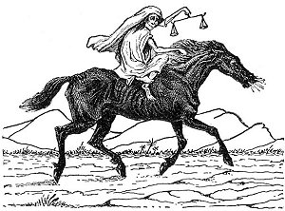
The Third Seal – The Black Horse
And when he had opened the third seal, I heard the third beast (the face of a man) say, Come and see. And I beheld, and lo a black horse; and he that sat on him had a pair of balances in his hand.
And I heard a voice in the midst of the four beasts say, “A measure of wheat for a penny, and three measures of barley for a penny; and see thou hurt not the oil and the wine.” (Revelation 6:5-6)

Slide 3
Key Word Analysis
Black - μέλας – melas –
  Meanings:
    Black
    Black Ink
  KJV Occurrences – 3 times: Matthew 5:36, Revelation 6:5, 12
Horse - ἵππος – hippos
  Meaning:
    Horse or horses
  KJV Occurrences – 16 times:
    Horse (8) all in the Book of Revelation
    Horses (8) 7 in the Book of Revelation and one in James 3:3

Slide 4
Key Word Analysis
A Pair of Balances - ζυγός – zugos –
  Meanings:
    A Yoke
      a yoke that is put on draught cattle
      metaphorically, used of any burden or bondage
        as that of slavery
        of troublesome laws imposed on one, especially of the Mosaic law, hence the name is so transferred to the commands of Christ as to contrast them with the commands of the Pharisees which were a veritable ‘yoke’; yet even Christ’s commands must be submitted to, though easier to be kept
    Balance, Pair of Scales
  KJV Occurrences – 6 times:
    Yoke (5) Matthew 11:29-30 (2), Acts 15:10, Galatians 5:1, I Timothy 6:1
    Pair of Balances (1)

Slide 5
Key Word Analysis
Measure, Measures - χοῖνιξ – choinix
  a choenix, a dry measure, containing four cotylae or two setarii (less than our quart, one liter) (or as much as would support a man of moderate appetite for a day)
  We now call it a “liter”
  KJV Occurrences – 2 times

Slide 6
Key Word Analysis
Hurt - ἀδικέω - adikeō
  absolute
    to act unjustly or wickedly, to sin
    to be a criminal, to have violated the laws in some way
    to do wrong
    to do hurt
  Transitive (affecting something else)
    to do some wrong (tort) or sin in some respect
    to wrong some one, act wickedly towards him
    to hurt, damage, harm
KJV Occurrences: 34
  Wrong – 11 (32.35%)
  Hurt – 10 (29.41%)
  Done – 3 (8.82%)
  Do – 2 (5.88%)
  Unjust – 2
  Wronged – 2
  Did – 1 (2.91%)
  Doeth – 1
  Injured – 1
  Offender - 1

Slide 7
Commodities
Items Traded in General Use

Slide 8
Key Word Analysis – The Grains
Wheat - σῖτος – sitos
  wheat, grain
    It should be noted than when “corn” is mentioned in the Bible, it refers to wheat, as corn is native to South America. In its original form, corn (Maize) was but three feet high and had an ear about one inch long. It was domesticated by Native Americans in Mexico about 9,000 years ago.
  Total KJV Occurrences – 14 times
    Wheat – 12 times
    Corn – 2 times (Mark 4:28, Acts 7:12)
Barley - κριθή - krithē
    Barley
    KJV Occurrence – 1 time

Slide 9
Key Word Analysis – Oilseed Markets
Oil - ἔλαιον – elaion
  Olive Oil
    Fuel for Lamps
    For Healing the Sick
    For Anointing the Head and Body at Feasts
    Mentioned Among Articles of Commerce
  Total KJV Occurrences: 11 (all translated “oil”)
Olive Oil is traded on the global oilseed markets along with Rapeseed (Canola), Palm (Copra) Oil, Soybean Oil, Cottonseed Oil, Sunflower Oil, and Peanuts.
  The Global Salad Oil Swindle of 1963

Slide 10
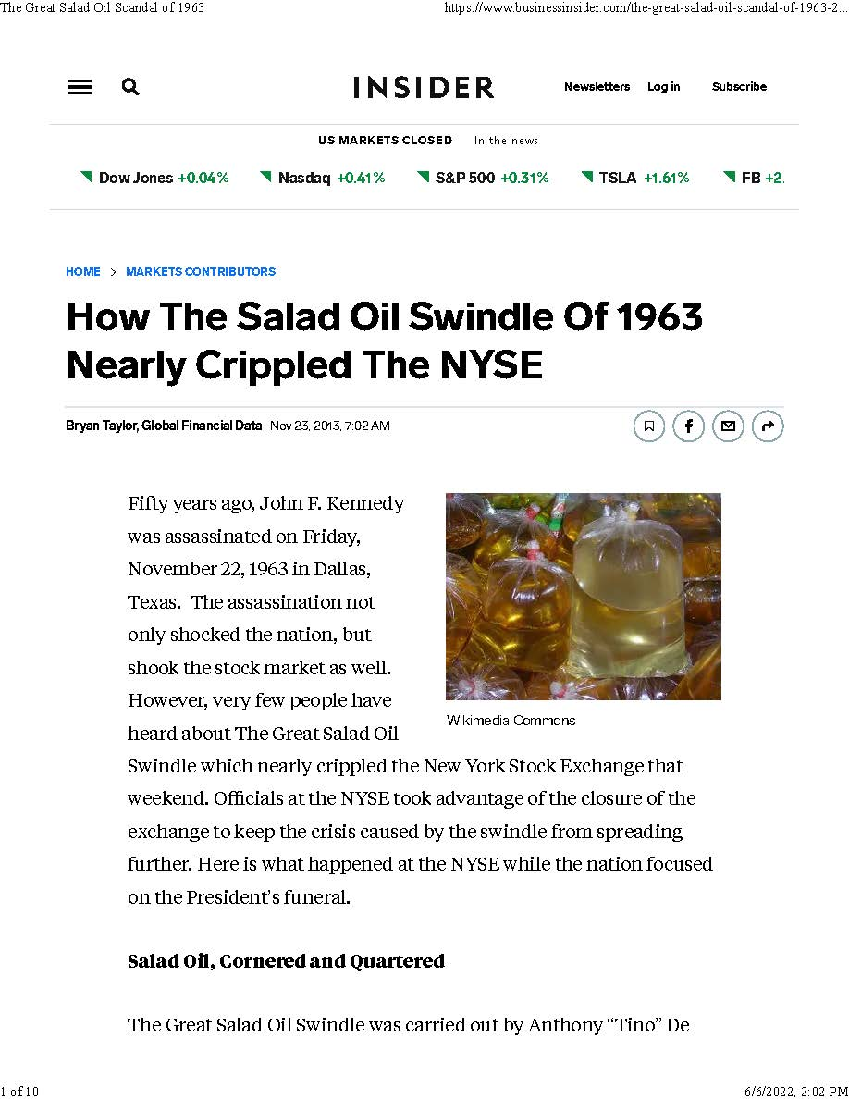

Slide 11
Key Word Analysis
Wine - οἶνος – oinos
  Wine
  Metaphorically Fiery Wine of YHWH’s Wrath
  KJV Occurrences: 33
    32 times “wine”
    1 time “Winepress” (Revelation 19:55)
Wine is now traded on exchanges around the world:
  Vinovest Exchange (Culver City, CA)
  London International Vintners Exchange
  CAVIX (London, England, United Kingdom)
  Livetrade (Bordeaux, France)

Slide 12
Currency in the End Times
The Specter of Massive Inflation!

Slide 13
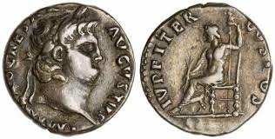
Key Word Analysis
Penny (1611 trans. “penie”) - δηνάριον - dēnarion
  Latin denarius, a Roman silver coin; the name originally valued at ten asses
KJV Occurrences – 16 times
  Penny – 9 times
  Pence – 5 times
  Pennyworth – 2 times

Slide 14
Understanding Money in Ancient Times as Compared to Modern Times
By the time John Mark was writing this part of the Book of Revelation, the Roman Denarius minting standard was about 3.9 grams of silver. A Legionary’s pay was 225 denarii per year starting in A.D. 44.
By comparison, an E-3 (PFC in the Army, Lance Corporal in the Marines, Seaman in the Navy) in the United States Military receives a monthly paycheck of $2,160.60 or $25,927.20. British paychecks are similar.
  In both cases, the soldiers/sailors ate at the Mess Hall/Galley and were billeted for free. They are given a housing allowance if they lived off-base.
  Transport from duty station to duty station is paid for by the military.
  In the U.S. Military, you also get additional pay for hazardous and combat duty.

Slide 15
Understanding English Money when the King James Version was Translated (1611-1769)
1 pound (₤) =
  20 shillings
  240 pence
12 shillings = 1 pence
1 guinea = 21 shillings
1 mark = 13 shillings, 4 pence
1 angel = 10 shillings
1 noble was equal to 6 shillings, 8 pence
1 crown was worth 5 shillings
Half-crowns were equal to 2 shillings, six pence
There were sixpence coins, three-pence coins, two-pence coins (called a tuppence), half-pence coins, and farthings (one quarter of a penny)
A penny was somewhat equivalent to one pence (but not quite)

Slide 16
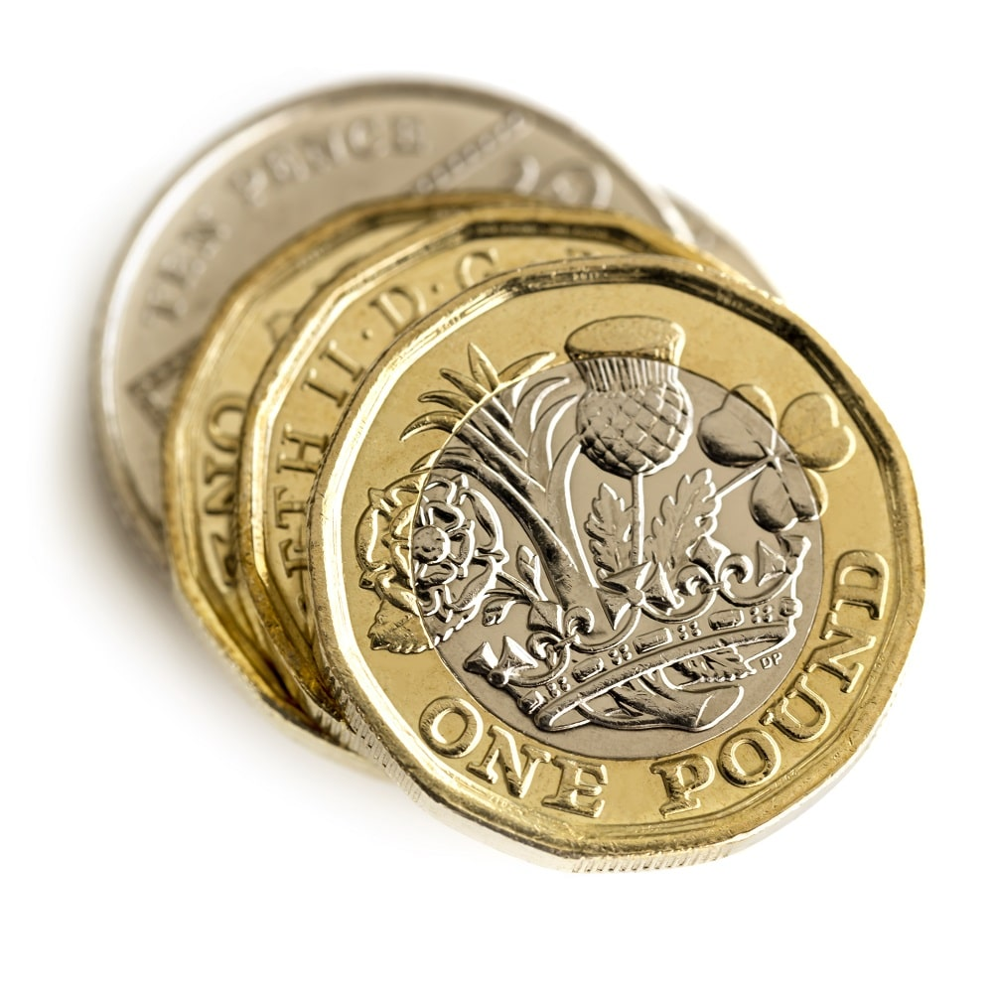
British Money at the Present
Pre-1971 British Money
1 pound (₤) =
  20 shillings
  240 pence
12 shillings = 1 pence
1 guinea = 21 shillings
Post-1971 British Money
1 pound (Quid) (£) =
  100 pence

Slide 17
Calculating Financial Equivalents
According to a calculator created by Eric Nye, University of Wyoming, the 1611 British Pound (£) in today’s dollars is worth $326.79.
If there are 240 pence to a British Pound, a pence is worth $1.36.
A measure of wheat is about one liter or a little less than a quart. There are 35.2390704 liters in a bushel (both US, dry and UK)
There are 28 grams in an ounce. The spot price for silver is $22.12 an ounce. To get the value of the silver in a denarii $22.12/28 * 3.9 = $ 3.08.
However, if a U.S. Soldier received 225 denarii like his Roman Counterpart, the soldiers’ denarii would be worth $115.23.
Eric W. Nye, Pounds Sterling to Dollars: Historical Conversion of Currency, accessed Sunday, May 29, 2022, https://www.uwyo.edu/numimage/currency.htm

Slide 18
Calculating Financial Equivalents
Using the $115.23 value for the denarii what is the cost of a bushel of wheat?
A measure (one liter) of wheat for a penny (denarii)…
  $115.232 * 35.2390704 = $4,060.67 for a bushel of wheat…
  The cost of a loaf of bread will likely be about $150.00.
  Right now, a measure of wheat can be purchased for 31.7¢. ($11.20¹ / 35.2390704)
¹https://www.gccoop.com/grain/cash-bids-futures

Slide 19
Calculating Financial Equivalents
It is clear from this prophecy that the world is headed for hyper-inflation.
  David Wilkerson prophesied this in his books: The Vision and Racing Toward Judgment.
  Don McAlvany, editor of the McAlvany Intelligence Advisor forecast that hyperinflation would be rampant in the 21st century. His son, David McAlvany and Kevin Oric still do a podcast called McAlvany Weekly Commentary. Here is a link to their latest warnings.
  Jim McKeever warned the world repeatedly about the prospect of hyperinflation in his newsletters (McKeever Strategy Letter and End Times News Digest) and his book: The Almighty and the Dollar about this event.
  Hundreds of other commentators are now making the same prediction.
  Consider the following events…

Slide 20
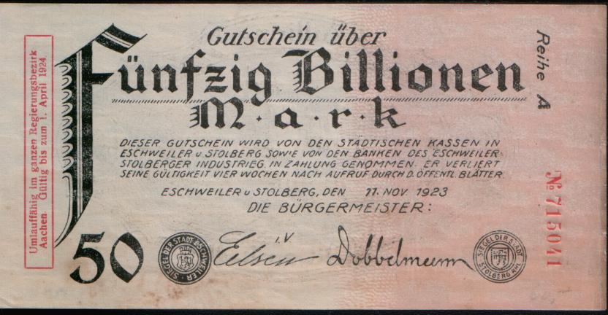
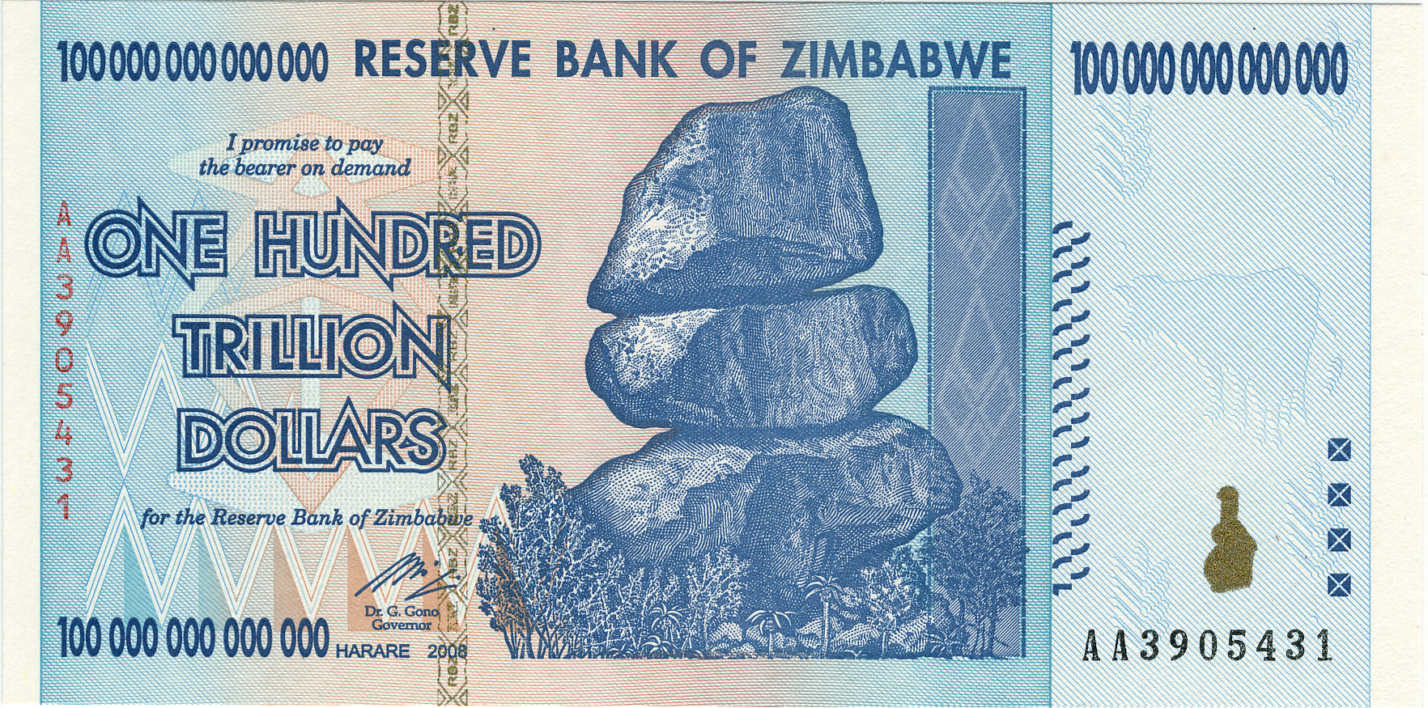
Historical Hyperinflation Equivalents
We have seen hyper-inflation like this other times:
  Weimar Germany After World War I. The Treaty of Versailles required Germany to pay “war reparations” to Allied Nations, causing Germany to lose most of its gold, which in turn, degraded its currency.
  Zimbabwe also had currency problems and eventually had to quit issuing currency after several tries. They now use the U.S. Dollar, South African Rand, British Pound, the Euro, Chinese Yuan, Japanese Yen, Indian Rupee, and the Botswana Pula for legal currency.
https://www.gccoop.com/grain/cash-bids-futures

Slide 21
The Dutch Experiment
Holland is home to the first Stock Markets in Western Europe.

Slide 22
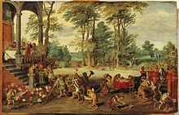
The Dutch Experiment (1600-1850)
Around 1600, The Netherlands started the most advanced economic systems in history.
The stock exchanges were very sophisticated and pioneered many innovations now common in all stock markets.
Much of the innovation came from the introduction of potatoes, peppers, tomatoes, and other vegetables to the West. However, in Holland, the biggest innovation came with the introduction of the tulip.
Horticulturalist Carolus Clusius developed a tulip bulb that would stand the harsh weather of the Low Countries. (The Netherlands, Belgium)

Slide 23
The Dutch Experiment (1600-1850)
Around 1600, The Netherlands started the most advanced economic systems in history.
The stock exchanges were very sophisticated and pioneered many innovations now common in all stock markets.
Much of the innovation came from the introduction of potatoes, peppers, tomatoes, and other vegetables to the West. However, in Holland, the biggest innovation came with the introduction of the tulip from the Ottoman Empire (now Turkey).
Horticulturalist Carolus Clusius developed a tulip bulb that would stand the harsh weather of the Low Countries. (The Netherlands, Belgium)

Slide 24
The Dutch Experiment (1600-1850)
The tulip became one of the most unique flowers in all of Europe. There was demand for them all over Europe. The Dutch varieties were demanded even more because they could be grown in harsh climates.
The Dutch East India Company became the first publicly-traded company in the world. It was incorporated by the Dutch Government on March 20, 1602, and given a 21-year monopoly to trade with Mughal India. Every trip a ship made to India returned a 400% return on investment.
In the late 1630s, the Dutch markets suffered a market crash and went through a “Great Depression” for a time. The most famous crash of that period was the Tulip Bulb Market Crash in 1637. Market Analysts still study this market crash, looking for ways to avoid future crashes.

Slide 25
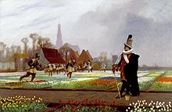
The Tulip Bulb Crash of 1637
When the Tulip Bulb Market crashed in 1637, the Dutch Government tried to destroy much of the tulip market by destroying the tulips.
As we see in the picture, the government ordered the destruction of the plants, NOT the removal and destruction of the bulbs.
For the most part, Holland’s markets recovered without substantial governmental intervention. History has demonstrated multiple times that governmental intervention does NOT help markets of any kind. Yet, that is what Klaus Schwab and the World Economic Forum’s “experts” plan to do for us with the “Great Reset.”
The Tulip Folly, by Jean-Léon Gérôme in 1882, a nobleman guards an exceptional bloom of tulips as soldiers trample the flowerbeds in a vain attempt to stabilize the tulip market by curtailing the supply.

Slide 26

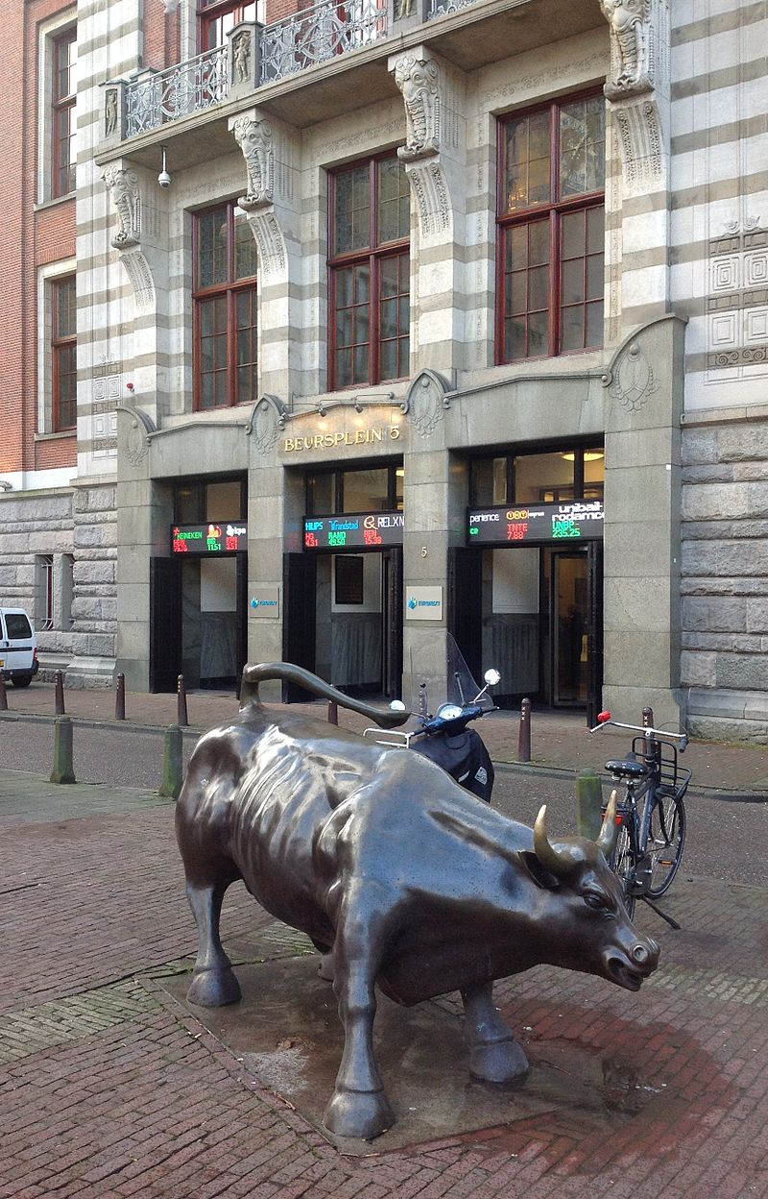
The Amsterdam Exchange
The Amsterdam Exchange remains one of the largest stock exchanges in the world.
They were the first stock exchange to trade options and futures on the same floor as the stocks. (It is still illegal in the USA)
The condition of this stock market can be measured via the AEX Index.
If you want your publicly-traded stock to get a foothold in Europe, the Amsterdam Exchange is the place to start.

Slide 27
Thank You for Listening
Prof. Tom Mack and
Maj. Tom Baird

