Slide 1

The Second Horse of the Apocalypse - Inflation
Part III

Slide 2
Updates
The Four Horsemen of the Apocalypse

Slide 3
Boris Johnson Resigns as Prime Minister
Boris Johnson, whose Conservative Party was elected to a majority in British Parliament in 2019, was subsequently chosen by his Party to be Great Britain’s Prime Minister. The Conservative Party had won the largest majority in Parliament since World War II.
  Boris Johnson led the United Kingdom OUT of the European Union. The British felt they were not receiving any benefit from being in the EU.
  Great Britain still maintains fairly good relations with the United States, France, The Netherlands, and Germany. Boris Johnson got along well with Donald Trump and his administration but has had problems with the Biden Administration.
  Links to the British TV Program House of Cards will be uploaded soon.

Slide 4
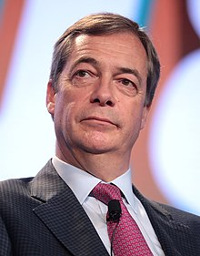
Boris Johnson Resigns as Prime Minister
Nigel Farage, British BREXIT Party Leader explained to Fox News that the Prime Minister lost the confidence of the Conservative Party and the British electorate.
  When the Conservative Party Members of Parliament (MPs) see this loss of confidence, they get worried that when their next elections come around in 2024, they might lose their seats.
  The British have elections every five years unless there is a “vote of no confidence.” When that happens, the Prime Minister must go to the Queen, who then dissolves Parliament and calls for elections in six months.
  If the ruling party thinks they can gain seats in an election, the Prime Minister can go to the Queen and ask her to dissolve Parliament and have new elections.
Nigel Farage

Slide 5
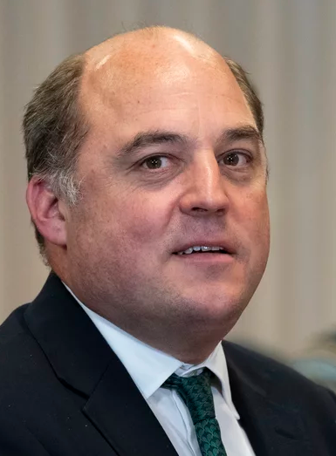
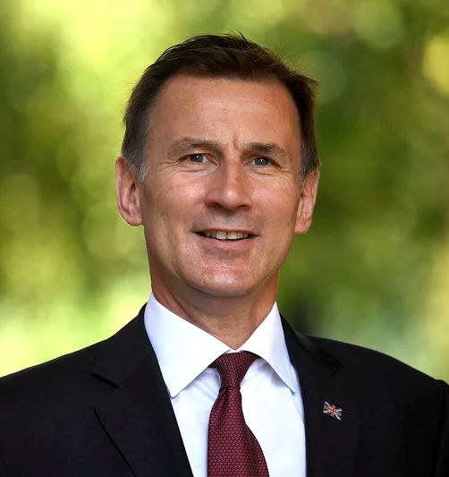





Replacement Prime Minister Candidates
Here is a list of potential Prime Ministers:
  Leading Candidates:
    Ben Wallace, Defense Minister
    Jeremy Hunt, Health Minister
    Rishi Sunak, Chancellor of the Exchequer
  Secondary Candidates:
    Liz Truss, Foreign Secretary
    Suella Braverman, Attorney General
    Penny Mordaunt, Trade Minister
    Chris Heaton-Harris, Chief Whip, Conservative Party

Slide 6
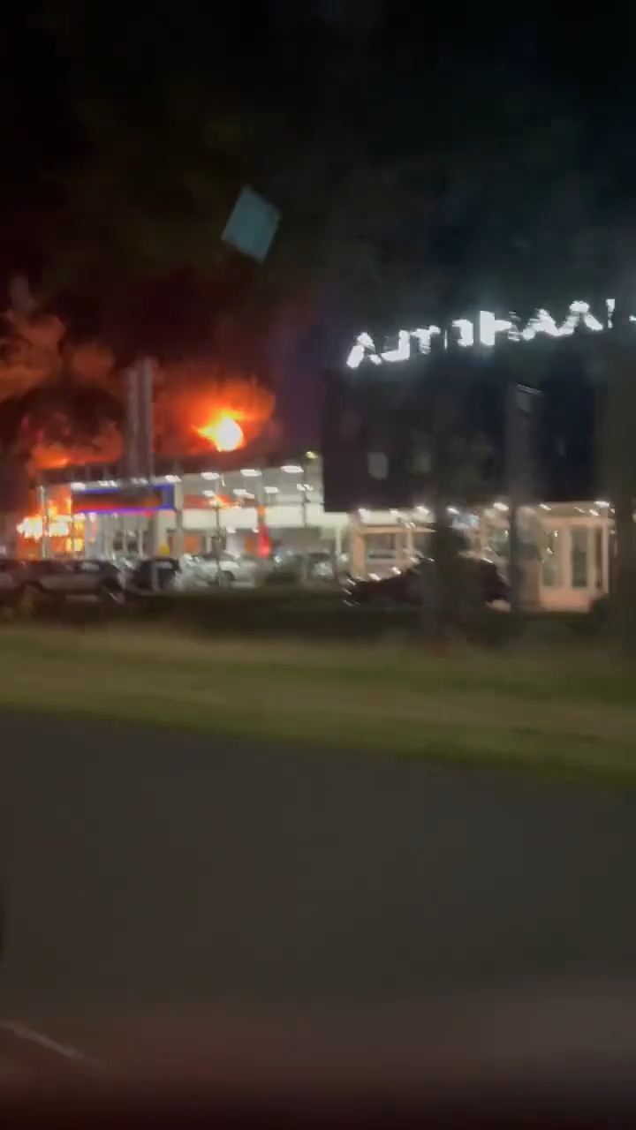

Farmers Strikes in Europe
Starting in The Netherlands, farmers have taken to the highways to protest high fuel prices and overly restrictive governmental regulations that have come about thanks to the policies of the Green Party.
  The Protests have now spread to Germany, France, and other countries.
  Many of these protests have gotten violent.
  Bill Gates Foundation supermarket in the Netherlands that sells “fake meat” has caught fire in the middle of the night on July 11.

Slide 7

Other News
The resistance to the Globalist Agenda has reached new levels now that the Firefighters in Holland have joined the farmers in their protest.
The Latvian Parliament has just dissolved their government and ordered new elections.
Olaf Schultz is now in trouble in Germany. Analysts now think that government will be out soon.
Israel is about to have new elections. Benyamin Netanyahu will soon be back as Prime Minister.
Joe Biden appears to be in more trouble. The Dems are mulling over what they can do?
  It has been reported that Kamala Harris has been taken out of circulation and is playing video games at the Naval Observatory where she lives. Robert Barnes says she is a “marginal attorney.”

Slide 8
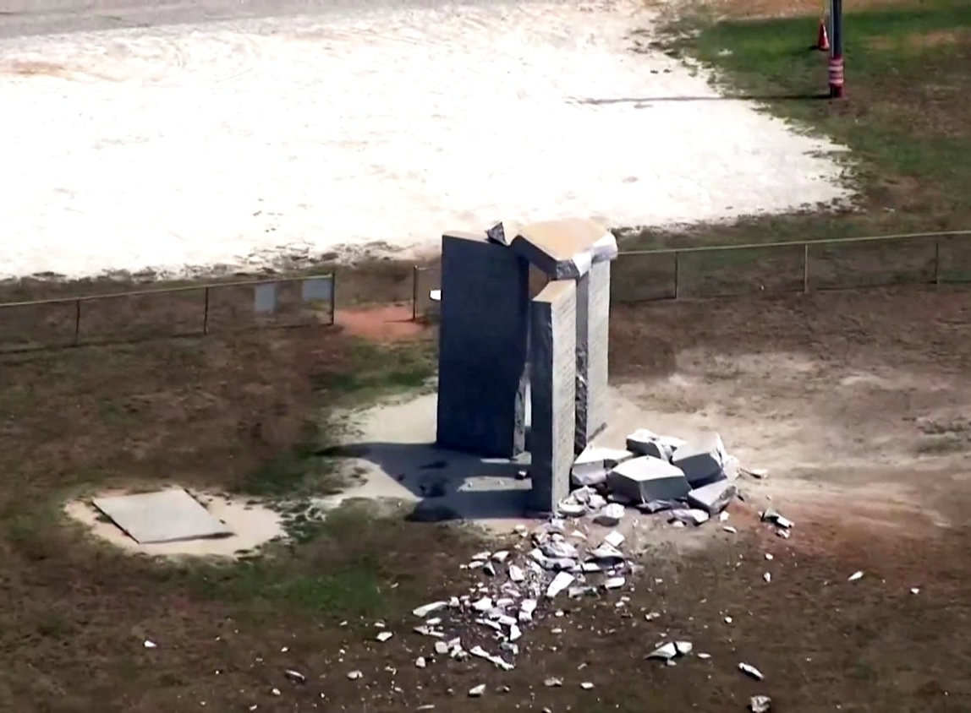
“Explosion”Rocks Georgia Guidestones
On July 6 at 0333 hours, an explosion rocked the Georgia Guidestones in Elbert County, Georgia. The stone that fell outlined the fact that the earth should only have 500,000,000 million people in its population.

Slide 9
WhiteStone Foundation Music Research
In anticipation of a trip to Heavener, Oklahoma later this summer, we did some more experimentation with our Bible Music Project.
  Much of the research we previously did is on our website: http://biblemusic.live.
  Much of that work from 2006-2012 centered around weather research and culminated with making it rain every day in June in 2012. Professor Mack was assisted by Olaf H. Hage III and Chris Blodgett, both in the construction of the music and in the scientific elements.
  On July 4, 2022, we embarked on a new project. In our first phase, we made music from Isaiah 9:8 to 13:33 in all 12 key signatures. We played the music out into the atmosphere for the first time that evening. Areas of drought suddenly got rain, but CERN did not operate as planned and there was a problem with the Georgia Guidestones.

Slide 10
WhiteStone Foundation Music Research
In anticipation of a trip to Heavener, Oklahoma later this summer, we did some more experimentation with our Bible Music Project.
  Tonight, we will release for the first time, the Bible Music for Isaiah 9:8 – 13:22.
  As we do additional research, we will post additional scriptures.

Slide 11
Inflation
Part II

Slide 12
Deflation and the Great Depression
When the Great Depression hit in the 1930s, commodity prices started to fall as demand for grains and oil plummeted. Many farmers lost their farms and many others struggled to keep their farms solvent.
Nationwide credit tightened, causing many companies lose their access to the credit needed to maintain their operations. When they could not obtain loans, they shut down their companies, laying off thousands of people.

Slide 13
Deflation and the Great Depression
The mass shutdowns of companies with lower credit ratings created alleged unemployment rates of 25%.
  At that time, the government had no standards by which to measure unemployment since the government did not offer unemployment insurance until 1935 and even then, it did not cover agricultural workers and domestic servants.
  Unemployment Insurance was part of the Social Security Act of 1935. It intentionally left out a lot of Black and Hispanic workers.

Slide 14
Deflation and the Great Depression
The mass shutdowns of companies with lower credit ratings created alleged unemployment rates of 25%.
  Accounting Standards were very lax or non-existent. Companies could report earnings that did not exist.
  Congress passed the Securities Act of 1933 which required public companies to be “audited” every year by a “public accountant.”
    The definitions of “audited” and “public accountant” were left vague by Congress, likely on purpose. The Securities and Exchange Commission (SEC) over the years, has refined those definitions.

Slide 15
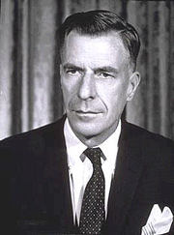
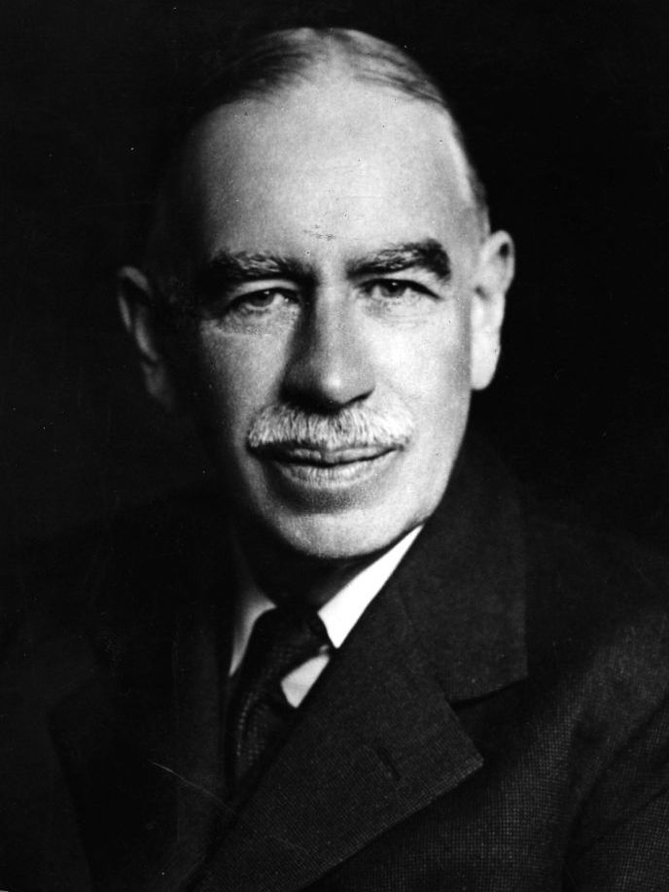
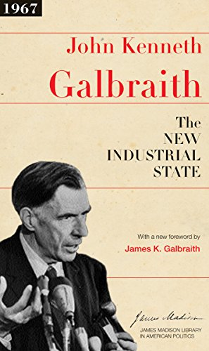
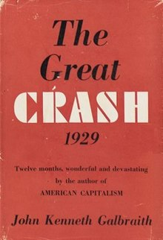
The Pre-World War II Economy
When liberal parties started taking over the Western governments in the 1930s, every one of them started ramping up social programs to “restart our economy.”
They were following the economic principles formulated by John Maynard Keynes, a member of British Parliament and a graduate of Cambridge University. He felt you could “restart an economy” by increasing consumer demand.
He also influenced the economics of Dr. John Kenneth Gilbreath, a long-time Harvard professor of economics. He would also influence many presidential administrations.

Slide 16
The Pre-World War II Economy
John Kenneth Gilbreath argued in his books that the Great Depression of the 1930s occurred because of “speculators” in our financial markets.
He theorized that our economy was stagnated by “established large corporations” who “controlled” the economy. He gave General Motors as an example. We’ll see if that is right!

Slide 17
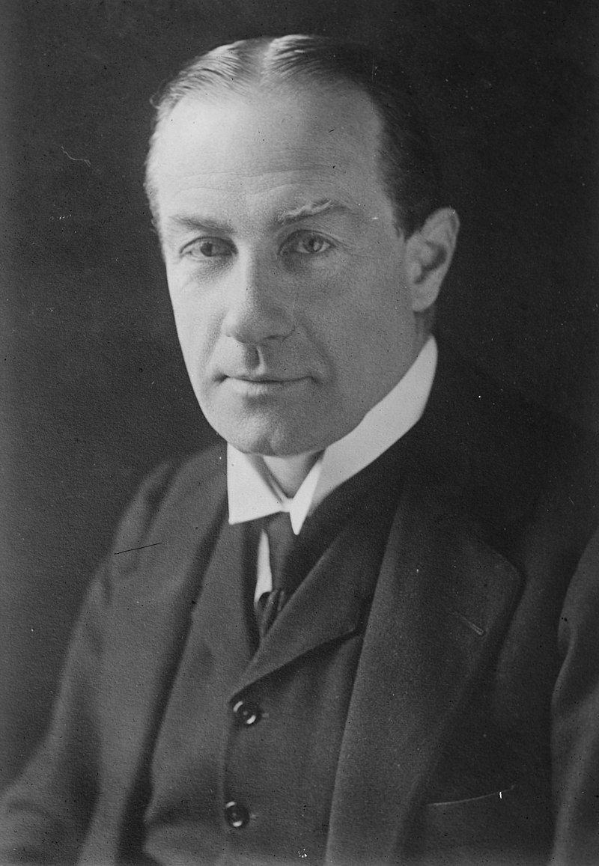
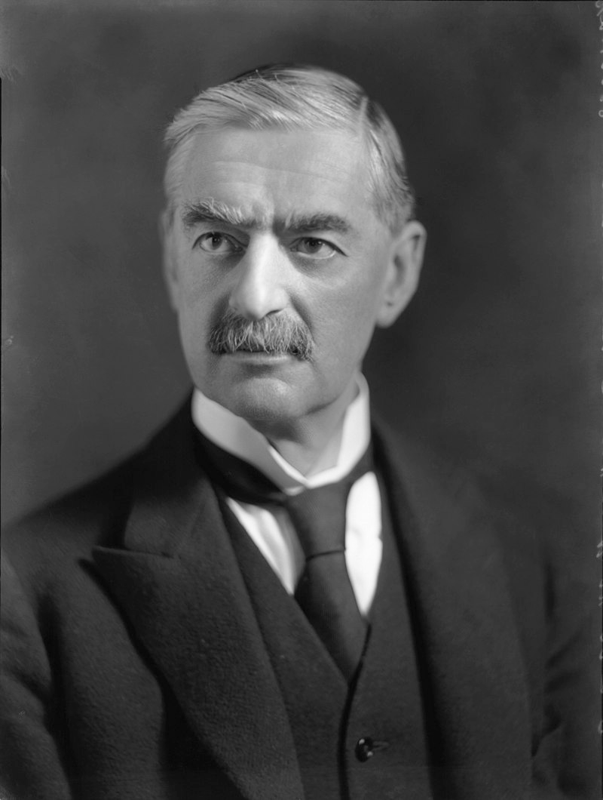
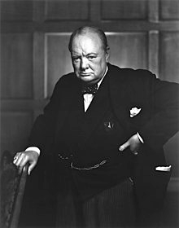
The Pre-World War II Economy
The Panic of 1937 frustrated the world economies. In Great Britain, the Conservative Party returned to power in 1935 under the leadership of Stanley Baldwin, then Neville Chamberlain, and then Winston Churchill.
  The socialist programs of Adolf Hitler again placed the German economy in danger, leaving the Germans with no choice but to start World War II.
  Japan’s economy was in similar straits, as was the Italian economy.
  The French economy also suffered but received aid from Great Britain and the United States. Unfortunately, their military leaders endeavored to refight World War I.

Slide 18
Post World War II Economy
During a War Economy, industries are geared up to support their nation’s war effort. We saw that in World War II and World War I.
  After the War, the European economies were devastated due to all the bombing on both sides. Many industries needed to be rebuilt.
  The United States developed The Marshall Plan to rebuild Western Europe, feeling it was in the best interest of the United States to build up its allies. The only damage the United States sustained was a couple of forest fires caused by Japanese balloons. Therefore, its industries could re-gear to help with the building effort.

Slide 19
Post World War II Economy
During a War Economy, industries are geared up to support their nation’s war effort. We saw that in World War II and World War I.
  The War still weakened Western Economies so that Belgium, Great Britain, France, The Netherlands, and even the United States lost most of their colonies around the world.
  By the late 1960s European countries were turning socialist causing their money supplies to exceed faster than their growth in the value of goods and services.
  The Marshall Plan was designed to suppress the potential of a Nazi Party resurrection in the coming decades.

