Slide 1

The Four Horsemen of the Apocalypse
Events Happening Before Our Eyes

Slide 2


Slide 3
Current Events
The apocalypse coming to pass right now!

Slide 4
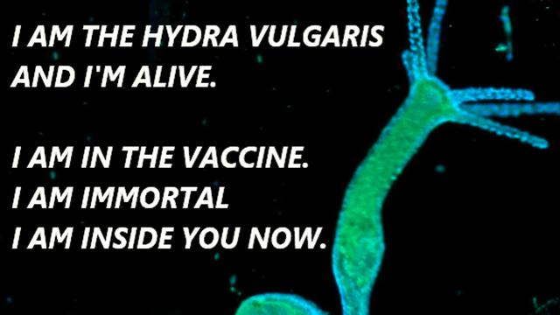
Courtesy of Dr. Carrie Madej: https://www.bitchute.com/video/2EXu0Zb9xLWP/

Slide 5
Interesting Note:
If indeed the organism Hydra Vulgaris is in the vaccine, it explains why the CDC tried to ban Ivermectin as a treatment for COVID-19. Ivermectin kills parasites!

Slide 6
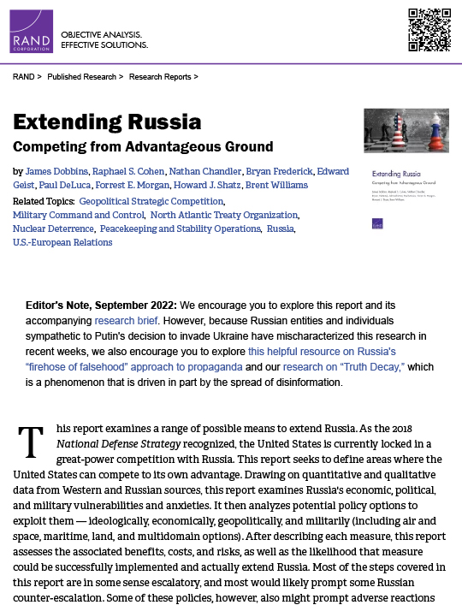

Slide 7
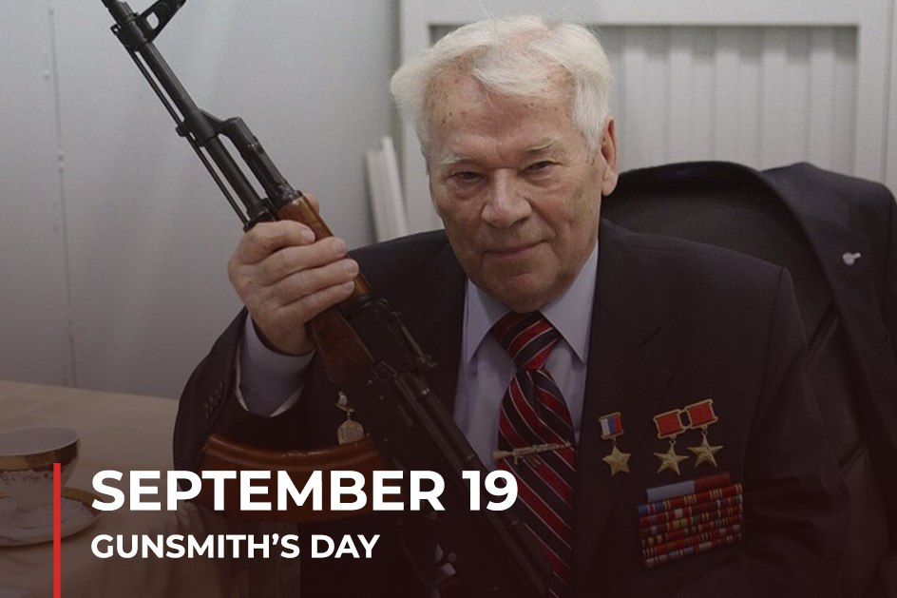
Per Russian Presidential Decree on December 3, 2011

Slide 8

Vladimir Putin and the Falcon

Slide 9
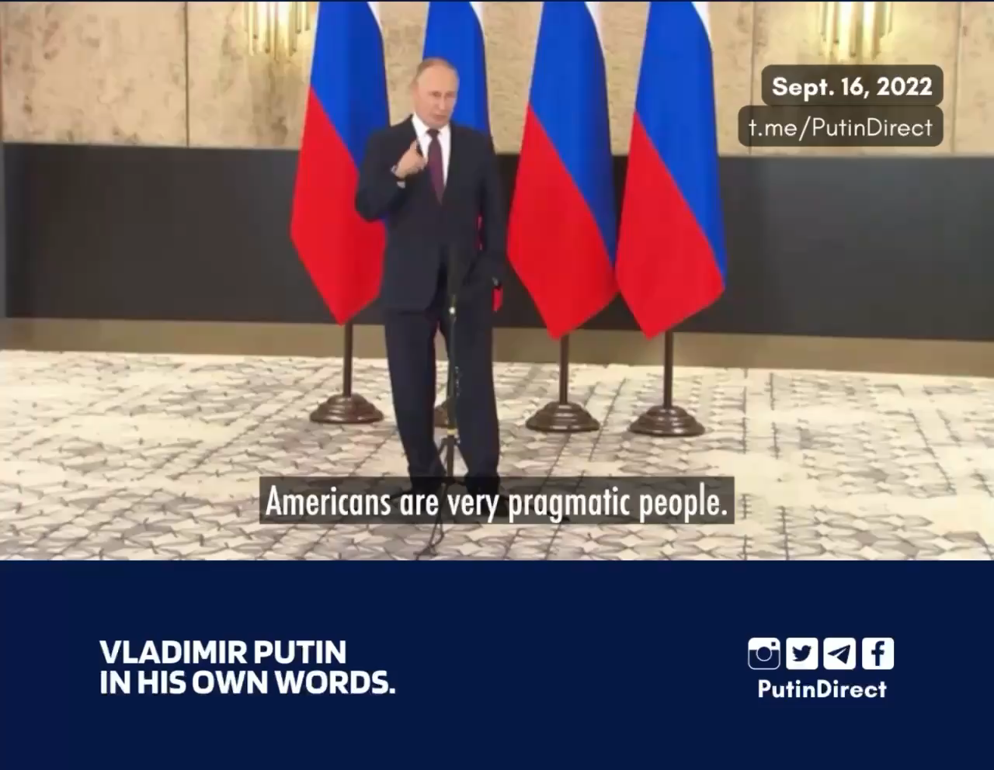
Putin on Ukrainian Grain Shipments
Putin: Much of the Ukrainian grain is actually American grain after Ukraine sold its farmlands to U.S. companies.

Slide 10
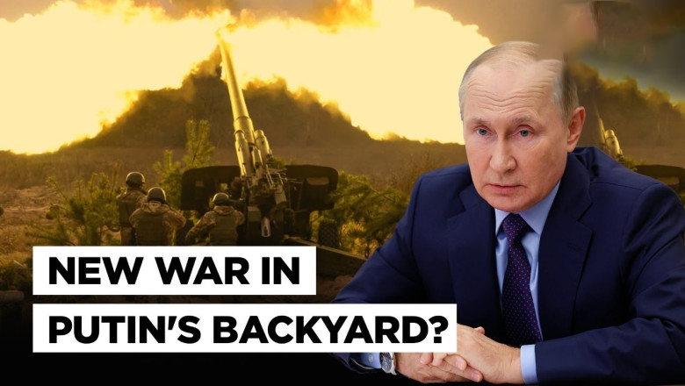

Slide 11
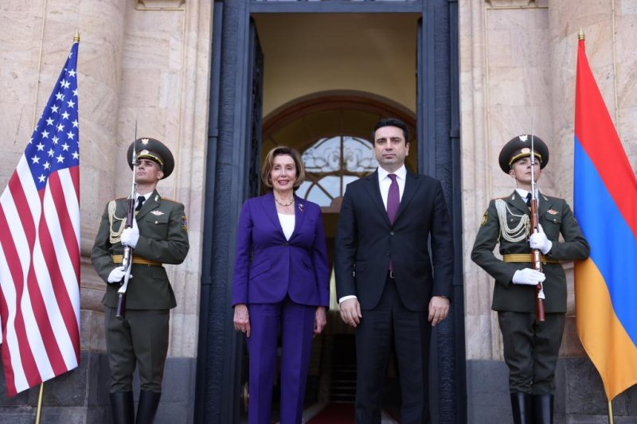

Slide 12
Nancy Pelosi in Armenia
Thomson-Reuters Headlines:
  Pelosi blames Azerbaijan for starting conflict
  Azerbaijan says Pelosi endangering peace in Caucasus
  Azerbaijan says Pelosi's remarks unacceptable
  Pelosi lauds Armenia's 'Velvet Revolution'
  U.S. listening to Armenia on defense, Pelosi says

Slide 13
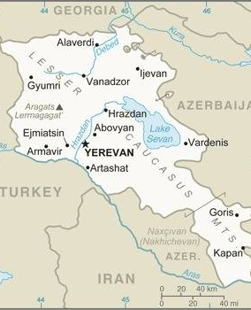
Armenia
The first country to adopt Christianity in the fourth century. The Armenian Orthodox Church remains the largest church in the country.
The Israelites, after they were captured by the Assyrians, were moved from the Promised Land to this part of the world.

Slide 14
Why are We Concerned About Armenia?
In the two and fiftieth year of Azariah king of Judah Pekah the son of Remaliah began to reign over Israel in Samaria, and reigned twenty years.
And he did that which was evil in the sight of YHWH: he departed not from the sins of Jeroboam the son of Nebat, who made Israel to sin.
In the days of Pekah king of Israel came Tiglath-pileser king of Assyria, and took Ijon, and Abel-beth-maachah, and Jonoah, and Kedesh, and Hazor, and Gilead, and Galilee, all the land of Naphtali, and carried them captive to Assyria.
And Hoshea the son of Elah made a conspiracy against Pekah the son of Remaliah, and smote him, and slew him, and reigned in his stead, in the twentieth year of Jotham the son of Uzziah.
And the rest of the acts of Pekah, and all that he did, behold, they are written in the book of the chronicles of the kings of Israel. (II Kings 15:27-31)

Slide 15
Why are We Concerned About Armenia?
In the twelfth year of Ahaz king of Judah began Hoshea the son of Elah to reign in Samaria over Israel nine years.
And he did that which was evil in the sight of YHWH, but not as the kings of Israel that were before him.
Against him came up Shalmaneser king of Assyria; and Hoshea became his servant, and gave him presents.
And the king of Assyria found conspiracy in Hoshea: for he had sent messengers to So king of Egypt, and brought no present to the king of Assyria, as he had done year by year: therefore the king of Assyria shut him up, and bound him in prison.
Then the king of Assyria came up throughout all the land, and went up to Samaria, and besieged it three years.
In the ninth year of Hoshea the king of Assyria took Samaria, and carried Israel away into Assyria, and placed them in Halah and in Habor by the river of Gozan, and in the cities of the Medes. (II Kings 17:1-6)

Slide 16
Territorial Spirits
And the king of Assyria brought men from Babylon, and from Cuthah, and from Ava, and from Hamath, and from Sepharvaim, and placed them in the cities of Samaria instead of the children of Israel: and they possessed Samaria, and dwelt in the cities thereof.
And so it was at the beginning of their dwelling there, that they feared not YHWH: therefore YHWH sent lions among them, which slew some of them.
Wherefore they spake to the king of Assyria, saying, The nations which thou hast removed, and placed in the cities of Samaria, know not the manner of the Elohim of the land: therefore he hath sent lions among them, and, behold, they slay them, because they know not the manner of the Elohim of the land. (II Kings 17:24-26)

Slide 17
Territorial Spirits
Then the king of Assyria commanded, saying, Carry thither one of the priests whom ye brought from thence; and let them go and dwell there, and let him teach them the manner of the Elohim of the land.
Then one of the priests whom they had carried away from Samaria came and dwelt in Bethel, and taught them how they should fear YHWH.
Howbeit every nation made elohim of their own, and put them in the houses of the high places which the Samaritans had made, every nation in their cities wherein they dwelt.
And the men of Babylon made Succoth-benoth, and the men of Cuth made Nergal, and the men of Hamath made Ashima,
And the Avites made Nibhaz and Tartak, and the Sepharvites burnt their children in fire to Adrammelech and Anammelech, the elohim of Sepharvaim. (II Kings 17:27-31)

Slide 18
Territorial Spirits
So they feared YHWH, and made unto themselves of the lowest of them priests of the high places, which sacrificed for them in the houses of the high places.
They feared YHWH, and served their own elohim, after the manner of the nations whom they carried away from thence.
Unto this day they do after the former manners: they fear not YHWH, neither do they after their statutes, or after their ordinances, or after the law and commandment which YHWH commanded the children of Jacob, whom he named Israel;
With whom YHWH had made a covenant, and charged them saying, Ye shall not fear other elohim, nor bow yourselves to them, nor serve them, nor sacrifice to them:
But YHWH, who brought you up out of the land of Egypt with great power and a stretched out arm, him shall ye fear, and him shall ye worship, and to him shall ye do sacrifice. (II Kings 17:32-36)

Slide 19
Territorial Spirits
And the statutes, and the ordinances, and the law, and the commandment, which he wrote for you, ye shall observe to do for evermore; and ye shall not fear other elohim.
And the covenant that I have made with you ye shall not forget; neither shall ye fear other elohim.
But YHWH your Elohim ye shall fear; and he shall deliver you out of the hand of all your enemies.
Howbeit they did not hearken, but they did after their former manner.
So these nations feared YHWH, and served their graven images, both their children, and their children's children: as did their fathers, so do they unto this day. (II Kings 17:37-41)

Slide 20

British Power Bills
The plan is simple: Raise prices to crushing heights and starve everyone out until the Middle Class is dissolved, globally.
People living in poverty are easiest to control as the Satanic elites usher in their Beast System.

Slide 21
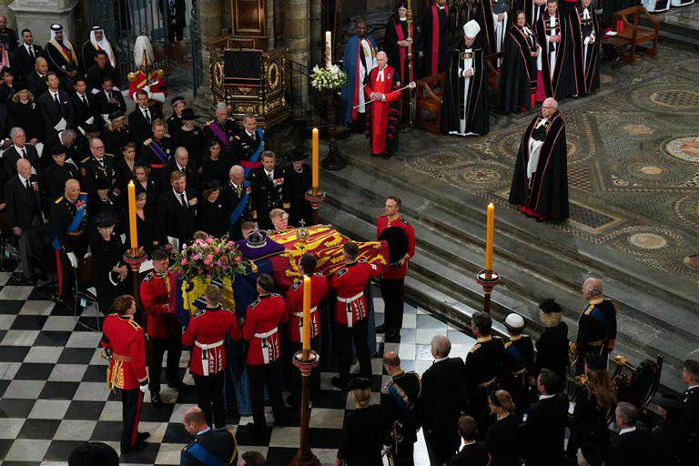
Queen Elizabeth II funeral on a dualistic masonic floor.

Slide 22
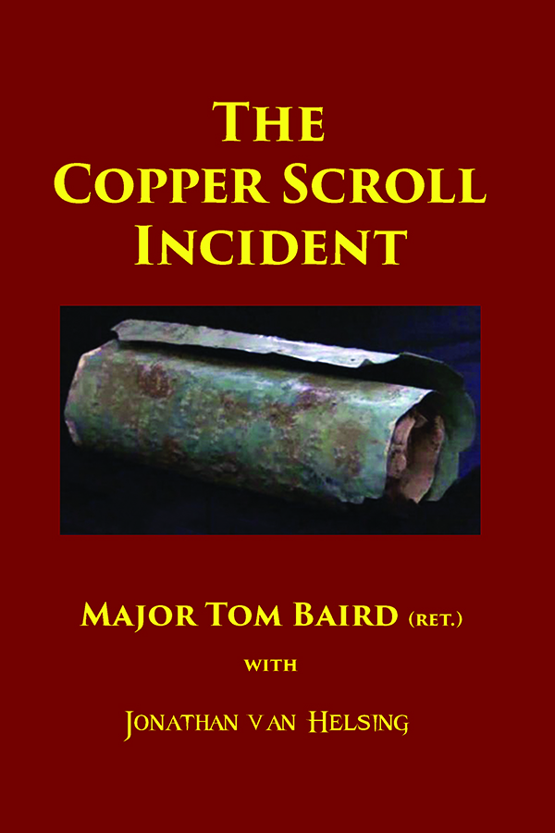

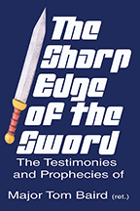
Websites
Major Tom Baird (ret.)
  http://aliveontheedge.com
  http://copperscrollincident.info
  Email: tom@aliveontheedge.com
  Telegram Channel: https://t.me/aliveontheedge

Slide 23
Websites
Prof. Tom Mack (ret.)
  Websites:
    http://whitestonefoundation.org
    http://biblecodes.co
    http://biblemusic.live
    http://whitecottagepublishing.com
    http://jonvanhelsing.com
    http://ancient-evil.org
    http://warfareprayers-book.com
http://heavenermysteries.info
http://antichristwatch.org
http://thetimequest.com
http://whitestonetechnologies.co
Telegram Channel:
  https://t.me/Bible_Music1
Email:
  tom.mack@whitestonefoundation.org

